Slide 1
C++ 11 & 14
M
o
d
e
r
n
C
+
+
98
C++ 98 major
08
99
00
11
C++ 11 major
01
12
02
13
03
C++ 03 bug fixes only
14
C++ 14 minor
04
15
05
16
06
Library performance improvements.
17
C++ 17 medium
07
18
11
++
C

Slide 2
C++ 11
The 3 important language features of C++ 11
Type Inference
Trailing return type syntax for functions
Lambda expressions
11
++
C

Slide 3
C++ 11
The 3 important language features of C++ 11
Type Inference :
The C++ 11 language now provides mechanism which helps the compiler to automatically deduce the type’s of expression.
It supports 2 different construct’s viz…
1. auto is used to declaring variables
2. decltype is a more general tool
Code with Type Inference
More concise
Less redundancy
More Flexible
11
++
C

Slide 4
C++ 11
The 3 important language features of C++ 11
auto:
auto x = 10; //‘x’ is of type ‘int’
auto obj1 = CA(10,20);
// ‘obj1’ is of type ‘CA’
list<int> ls1;
for(auto itr = ls1.begin();
itr != ls1.end(); itr++)
{
//… now ‘itr’ is of type
list<int>::iterator
}
Something's have to be manual, ‘auto’ cannot be used everywhere
They cannot be used for formal parameters of a function
eg: int fun(auto x){….}
They cannot be used to declare a data-member in a class
eg: class CA
{
private:
auto x;
}
They cannot be used for a array declaration.
eg: auto arr[10];

Slide 5
C++ 11
The 3 important language features of C++ 11
auto continued…
auto a= 3.0, b=4.0; //OK ‘a’ & ‘b’ is ‘double’ type
auto i=1.0, *ptr = &a, &ref=b; //OK
‘i’ is ‘double’ type
‘ptr’ is ‘double *’ type
‘ref’ is ‘double &’ type
auto j = 50, str =“HELLO”; //ERROR
//all types in the declaration must be homogenous types…
‘const’ qualifier can also be used along with ‘auto’ if we really need them.
const auto x = 100;
const auto &ref = x;
const and volatile specifier’s are removed
- Arrays and functions are turned into pointers.

Slide 6
C++ 11
The 3 important language features of C++ 11
auto continued…
const and volatile specifier’s are removed when associated with elements either qualified with ‘const’ or ‘volatile’ qualifiers.
Arrays and functions are turned into pointers.
const vector<int> values;
auto a=values; //type of ‘a’ is vector<int>
auto &b = values; //type of ‘b’ is const vector<int>&
volatile long clock =0;
auto c=clock; // ‘c’ is not volatile
Employee emp[10];
auto e = emp; // type of ‘e’ is Employee*
auto &f = emp; //type of ‘f’ is Employee(&)[10] – an array of reference
int func(double x) { return 100; }
auto g = func; // type of ‘g’ is int(* )(double)
auto &h = func; // type of ‘h’ is int(& ) (double)

Slide 7
M
o
d
e
r
n
C
+
+
14
Return type deduction
// Deduce return type as `int`.
auto f(int i) { return i;}
template <typename T>auto& f(T& t)
{
return t;
}
// Returns a reference to a deduced type.
auto g = [](auto& x) -> auto&
{
return f(x);
};
int y = 123;
int& z = g(y); // reference to `y`
Trainer: A.M.P.Ganesh Prabhu

Slide 8
C++ 11
The 3 important language features of C++ 11
decltype:-
You pass an expression and it automatically deduces the type of the expression. It is meant to be a type-specifier and would work only on valid expressions.
double d=10.0;
cout << typeid(decltype(d * 2.3)).name() << endl; //OK will output ‘double’
class CA
{
private:
CA(); //constructor is under private access specifier
};
cout << typeid(decltype(CA())).name() << endl; //ERROR, will not compile
Can overcome the above problem with ‘declval’ template
cout << typeid(declval<CA>()).name() << endl; //OK

Slide 9
M
o
d
e
r
n
C
+
+
14
decltype(auto)
The `decltype(auto)` type-specifier also deduces a type like `auto` does. However, it deduces return types while keeping their references or constness, while `auto` will not.
const int x = 0;
auto x1 = x; // int
decltype(auto) x2 = x; // const int
int y = 0;
int& y1 = y;
auto y2 = y1; // int
decltype(auto) y3 = y1; // int&
int&& z = 0;
auto z1 = std::move(z); // int
decltype(auto) z2 = std::move(z); // int&&
int x = 123;
static_assert(std::is_same<const int&, decltype(f(x))>::value == 0);
static_assert(std::is_same<int, decltype(f(x))>::value == 1);
static_assert(std::is_same<const int&, decltype(g(x))>::value == 1);
Note: Especially useful for generic code!
// Return type is `int`.
auto f(const int& i)
{
return i;
}
// Return type is `const int&`.
decltype(auto) g(const int& i)
{
return i;
}
Trainer: A.M.P.Ganesh Prabhu

Slide 10
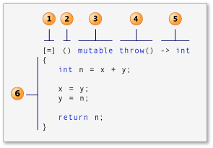
C++ 11
Properties of Lambda Expressions:-
Anonymous Function that gives a great degree of flexibility
lambda-introducer (Also known as the capture clause)
lambda declarator (Also known as the parameter list)
mutable (Also known as the mutable specification)
exception-specification (Also known as the exception specification)
trailing-return-type (Also known as the return type)
compound-statement (Also known as the lambda body)

Slide 11
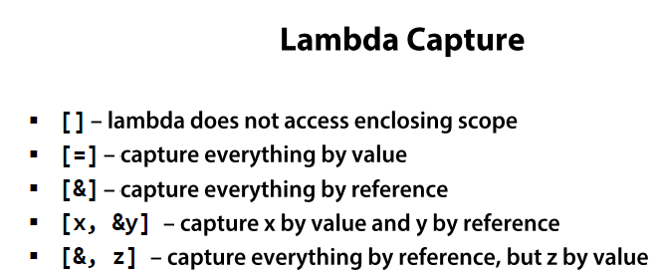
C++ 11
Properties of Lambda Expressions:-
The parameters of a Lambda expression cannot take default arguments in C++11, Now allowed in C++14
No variable length arguments in C++11, Now allowed in C++14
No un-named parameters
Cannot use ‘auto’ specifier for a class data member if it’s a lambda handle. Use ‘functional’ header to define function objects.

Slide 12
M
o
d
e
r
n
C
+
+
14
Generic lambda expressions
C++14 now allows the `auto` type-specifier in the parameter list, enabling polymorphic lambdas.
auto identity = [](auto x) { return x; };
int three = identity(3); // == 3
std::string foo = identity("foo"); // == "foo“
an Identity function that takes an argument and returns the same argument.
auto Identity = [](auto x) { return x; };
Identity(3); // 3
Trainer: A.M.P.Ganesh Prabhu

Slide 13
M
o
d
e
r
n
C
+
+
14
Lambda capture initializers
This allows creating lambda captures initialized with arbitrary expressions. The name given to the captured value does not need to be related to any variables in the enclosing scopes and introduces a new name inside the lambda body. The initializing expression is evaluated when the lambda is _created_ (not when it is _invoked_).
int factory(int i) { return i * 10; }
auto f = [x = factory(2)] { return x; };
cout << f(); // returns 20
Because it is now possible to _move_ (or _forward_) values into a lambda that could previously be only captured by copy or reference we can now capture move-only types in a lambda by value. Note that in the below example the `p` in the capture-list of `task2` on the left-hand-side of `=` is a new variable private to the lambda body and does not refer to the original `p`.
auto p = std::make_unique<int>(1);
auto task1 = [=] { *p = 5; }; // ERROR: std::unique_ptr cannot be copied
// vs.
auto task2 = [p = std::move(p)]
{ *p = 5; }; // OK: p is move-constructed into the closure object
// the original p is empty after task2 is created
Trainer: A.M.P.Ganesh Prabhu

Slide 14
C++ 11
Class Features Overview:-
In-class initializers for non-static data members
Delegating constructors
Inheriting constructors
Default methods
Delete methods
overide and final specifiers
Extended friend declarations
Nested class access rights

Slide 15
C++ 11
Class Features Overview contd…:-
C++11 now allows initialization of non-static data members of a class at the point of declaration itself.
class CA
{
private:
int a{ }; //OK, will take default value 0
int b{10}; //OK, will take ‘10’
float c=10.23f; //OK, can use ‘=‘ operator
double d(56.12); //ERROR, cannot use brackets
int sum = a+b; //OK, can be initialized with an expression
int total = this->compute(); //OK, can be initialized with non-static
// method call
float result = CA::static_fun(); //OK, can be initialized with static
// method call
public:
//……..
int compute(){ …. }
static float static_fun() {….}
};

Slide 16
C++ 11
Delegating constructors
The compiler feature allows a class type's constructor (the delegating constructor) to have a constructor call of its own class in its initialization list. So when we previously had to write code like this.
class Error
{
private:
void Init(int errorCode, const char* message)
{ //... }
public:
Error()
{
Init(0, "Success");
}
Error(const char* message)
{
Init(-1, message);
}
};

Slide 17
C++ 11
Delegating constructors (contd..)
With delegating constructors, we can achieve the same as follows…
class Error
{
private:
Error(int errorcode, const char* message)
{
//…
}
public:
Error():Error(0,”Success”)
{
//…
}
Error(const char* message):Error(-1, message)
{
//…
}
};

Slide 18
C++ 11
Inheriting constructors:-
class Base
{
public:
Base(){ }
Base(int x){ }
Base(int x, int y) { }
//...
};
class Derived:public Base
{
public:
using Base::Base;
Derived() /* : Base() */
{ }
Derived(int x) /* :Base(x) */
{ }
Derived(int x, int y) /* :Base(x,y) */
{ }
//...
};
Derived obj1(10);
As per the new standard the Derived class constructors are expected to handle the call to the appropriate base class constructors, without the programmer having to employ explicit call to the appropriate base in the derived class constructor initializer list.
Code assumed or generated by the compiler on our behalf

Slide 19
C++ 11
Default Methods:-
If in case we wouldn’t like to implement the following methods in the class,
Default constructor
Copy constructor
Assignment function
and would be more happy with compiler generated ones , which are by default public…Then, the same can be requested or explicitly stated to the compiler in the following manner….
//APPROACH 1
class CA
{
public:
CA()=default;
CA(const CA &)=default;
CA& operator =(const CA &)=default;
};
//APPROACH 2
class CA
{
protected:
CA(const CA &)=default;
public:
CA()=default;
CA& operator =(const CA &)=default;
};

Slide 20
C++ 11
Delete Methods:-
As opposed to ‘default’ discussed earlier, We can also apply the ‘delete’ keyword to methods. If applied these methods will not have any implementation details and is un-callable & cannot be used in any way.
For example, we don’t want our class to support the following list of methods…
Default constructor
Copy constructor
- The copy assignment function
-Move constructor
-The move assignment function
Note: Unlike ‘default’ which is only applicable to compiler generated methods, the ‘delete’ keyword can be associated with both compiler generated methods as well as custom functions written by the programmer.
class CA
{
public:
CA()=delete;
CA(const CA &)=delete;
CA& operator =(const CA &)=delete;
CA(CA &&)=delete;
CA& operator =(CA &&)=delete;
};

Slide 21
C++ 11
Deleted Methods continued:-
Can also be used to….
Disable some instantiations of the template
Disable unwanted conversion
Disable heap allocation
1.
template<typename T> void Add(T a, T b)
{
//….
}
//Disable for ‘char’ types
template<> void Add(char, char) = delete;
2.
class CA
{
public:
CA(int x){ }
//Disable conversion of CA type to int type
operator int() = delete;
};
3.
class CA
{
public:
CA(int x){ }
//Disable heap instances for CA
void* operator new(size_t size) = delete;
};

Slide 22
C++ 11
Overide & final
They assist the programmer in controlling or imposing stricter rules around inheritance. Both these keywords are context sensitive, as they can be used outside the class scope as names of variables. For Eg:
//here the variable names are incidentally keywords, will still work fine
int override =10;
int final = 20;
The overide keyword when used in a derived class member function explicitly states it is over-riding a base class method with same name and signature as that of the base class virtual method, if any difference in the form then the compiler would flag-off error.
class Derived:public Base
{
public:
void fun(int x) override //OK
{…. }
void fun(double x) override //ERROR
{…}
};
class Base
{
public:
virtual void fun(int x){ }
};

Slide 23
C++ 11
Overide & final (continued..)
The final keyword can be either used with class type or associated with a member function of a class.
When associated with class, it disallows inheritance.
When used with a method, it indicates that this method cannot be over-ridden in the derived class.
class Base
{
public:
virtual void fun(){ }
};
class Derived1:public Base
{
public:
void fun() final
{ }
};
class Derived2:public Derived1
{
public:
void fun() //ERROR, cannot override
{ }
};
class Base final
{
//…
};
class Derived:public Base //ERROR
{
//…
};

Slide 24
C++ 11
Extended Friend Declarations:-
We can now make a friend without a class keyword
In addition ‘typedef’ names can be declared as friends as long as we omit the ‘class’ keyword
class A;
class B;
class Friend
{
friend class A; //OK, old style still works
friend B; //OK, new style
};
class CA
{
friend class D; //OK, declares new class D
friend D; //ERROR, undeclared class D
};
class CB;
typedef CB B; // (or) using B=CB;
class CA
{
friend B; //OK
};

Slide 25
C++ 11
Extended Friend Declarations:-
The new style also allows template parameters to be declared as friends
template<typename T1, typename T2>class Amigo
{
friend T1; //OK,
friend class T2; //ERROR, cannot use an elaborate specifier inside
};
Amigo<string, string> a1; //OK
Amigo<char, string> a2; //OK, but friend char has no effect in the template

Slide 26
C++ 11
Nested class access rights:-
In the earlier version of C++ (03), the members of a nested (enclosed) class did not have special access to the members of the enclosing class. This defect is now rectified in C++ 11.
The current rule says the enclosed class is a member of the enclosing class and has the same rights as other members of the enclosing class.
class CA
{
private:
int adata;
class CB{ … };
class CC
{
CB bdata; //OK, CA::CC can have access to CA::CB
void fun(CA &x, int z)
{
x.adata = z; //OK, CA::CC can have access to CA::adata
}
};
};

Slide 27
C++ 11
TEMPLATE FEATURES
Default arguments for function templates
Rvalue and Lvalue
Perfect forwarding
Reference collapsing
Variadic Templates
Template Aliases
Local and un-named types as template arguments
Extern templates
Narrowing conversions

Slide 28
C++ 11
Default template arguments for function templates
This is yet another C++ 11 feature that's now supported in VC++ 2013. Until now, the following code would not compile with earlier versions of VC++.
template <typename T = int> void Foo(T t = 0) // error C4519: default template arguments
{ // are only allowed on a class template
//…
}
Visual C++ 2013 & above compiles this fine, and the template type is inferred correctly.
Foo(12L); // Foo<long>
Foo(12.1); // Foo<double>
Foo('A'); // Foo<char>
Foo(); // Foo<int>
template <typename T> class Manager
{
public:
void Process(T t) { }
};
template <typename T> class AltManager
{
public:
void Process(T t) { }
};
template <typename T, typename M = Manager<T>> void Manage(T t)
{
M m;
m.Process(t);
}
Manage(25); // Manage<int, Manager<int>>
Manage<int, AltManager<int>>(25); // Manage<int, AltManager<int>>

Slide 29
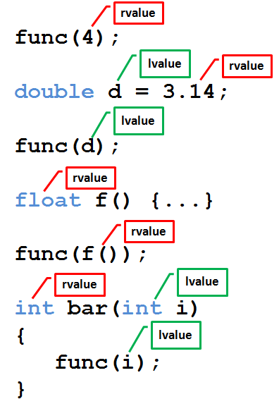
C++ 11
lvalue and rvalue types
rvalue

Slide 30
C++ 11
The perfect forwarding problem
Let’s say we would like to define a function with generic parameters that forwards its parameters perfectly to some other function.
The first approach that comes to mind is:
template <typename T1, typename T2> void wrapper(T1 &e1, T2 &e2)
{
func(e1, e2);
}
The above function calls would be OK as long as the inputs are lvalues, If rvalues are provided as input ,it would flag-off error. For eg:-
int a=…; float b=..;
wrapper(a,b); // OK will compile
wrapper(10, 12.34f); //ERROR will not compile
What remains is the brute-force approach , define overloads for both const and non-const references:
template <typename T1, typename T2> void wrapper(T1 &e1, T2 &e2){ }
template <typename T1, typename T2> void wrapper(const T1 &e1, T2 &e2){}
template <typename T1, typename T2> void wrapper(T1 &e1, const T2 &e2){ }
template <typename T1, typename T2> void wrapper(const T1 &e1, const T2 &e2){ }
Just imagine the exponential explosion of ‘wrapper’ getting overloaded.. This isn’t a clearly scalable solution.

Slide 31
C++ 11
Reference collapsing and special type deduction for rvalues
Taking a reference to a reference is illegal in C++. However, it can sometimes arise in the context of templates and type deduction:
template <typename T> void baz(T t) { T& k = t; }
What happens if we call this function as follows:
int ii = 4; baz<int&>(ii);
In the template instantiation, T is explicitly set to int&. So what is the type of k inside? What the compiler "sees" is int& & - while this isn't something the user is allowed to write in code, the compiler simply infers a single reference from this. In fact, prior to C++11 this wasn't standardized, but many compilers accepted such code anyway because these cases occasionally arise in template metaprogramming. With the addition of rvalue references in C++11, it became important to define what happens when various reference types argument are used (e.g. what does int&& & mean?).
The result is the reference collapsing rule. The rule is very simple. & always wins.
So & & & is &, and so are && & and & &&. The only case where && emerges from collapsing is && &&.

Slide 32
C++ 11
Reference collapsing and special type deduction for rvalues (contd..)
The other addition to C++11 relevant to this article is special type deduction rules for rvalue references in some cases. Given a function template like:
template <class T> void func(T&& t) { }
When it appears in a type-deducing context, T&& acquires a special meaning. When ‘func’ is instantiated, T depends on whether the argument passed to ‘func’ is an lvalue or an rvalue. If it's an lvalue of type U, T is deduced to U&. If it's an rvalue, T is deduced to U:
func(4); // 4 is an rvalue: T deduced to int
double d = 3.14; func(d); // d is an lvalue; T deduced to double&
float f() {...}
func(f()); // f() is an rvalue; T deduced to float
int bar(int i)
{
func(i); // i is an lvalue; T deduced to int&
}
This rule may seem unusual and strange. However, it starts making sense when we realize it was designed to solve the perfect forwarding problem.

Slide 33
C++ 11
Solving perfect forwarding with std::forward
Let's get back to our original wrapper template. Here's how it should be written in C++11:
template<typename T1, typename T2> void wrapper(T&& e1, T2&& e2)
{
func(forward<T1>(e1), forward<T2>(e2));
}
And the forward function from <utility> header:-
template<typename T> T&& forward(remove_reference<T>::type &t)
{
return static_cast<T&&>(t);
}
Let's say we call:
int ii; //lvalue
float ff; //lvalue
wrapper(ii, ff);
The wrapper function instantiation would be like this…
void wrapper(int &e1, float &e2)
{
fun(forward<int&>(e1), forward<float&>(e2));
}

Slide 34
C++ 11
Solving perfect forwarding with std::forward (contd..)
Further, the call to ‘forward’ function inside the ‘wrapper’ function would be instantiated like this…
//the argument passed are lvalue's by reference to 'func'
1. First 'forward' call
int& && forward(int& t) noexcept
{
return static_cast<int& &&>(t);
}
finally....After reference collapsing
int& forward(int& t) noexcept
{
return static_cast<int&>(t);
}
2. Second 'forward' call
float& && forward(float& t) noexcept
{
return static_cast<float& &&>(t);
}
finally.... After reference collapsing
float& forward(float& t) noexcept
{
return static_cast<float&>(t);
}

Slide 35
C++ 11
Solving perfect forwarding with std::forward (contd..)
The next case to handle is
wrapper(10, 12.34f);
Here the arguments are rvalues, so the wrapper function instantiation would be like this…
void wrapper(int e1, float e2) //void wrapper(int&& e1, float&& e2)
{
fun(forward<int>(e1), forward<float>(e2));
}
//the argument passed are rvalue's by reference to 'func‘
First 'forward' call
int&& && forward(int&& t) noexcept
{
return static_cast<int&& &&>(t);
}
finally....After reference collapsing
int forward(int t) noexcept
{
return static_cast<int>(t);
}

Slide 36
C++ 11
Solving perfect forwarding with std::forward (contd..)
2. Second 'forward' call
float&& && forward(float&& t) noexcept
{
return static_cast<float&& &&>(t);
}
finally.... After reference collapsing
float forward(float t) noexcept
{
return static_cast<float>(t);
}

Slide 37
C++ 11
LVALUE COPY
LVALUE COPY
CB obj1(10,20);
CB obj1
CB obj2
CB obj2(obj1);
CA* p
CA* p
stack
###
###
heap
a
10
10
a
b
20
20
Deep copy
b
CA
CA

Slide 38
C++ 11
LVALUE ASSIGNMENT
CB obj3(40,50),obj4;
CB obj3
CB obj4
CA* p
CA* p
stack
###
###
heap
a
40
a
0
b
50
b
0
CA
CA

Slide 39
C++ 11
LVALUE ASSIGNMENT
obj4 = obj3;
CB obj3
CB obj4
CA* p
CA* p
stack
###
###
heap
a
40
a
40
b
50
Deep ASSIGNEMNT
b
50
CA
CA

Slide 40
C++ 11
RVALUE COPY
RVALUE COPY
CB obj1(10,20);
CB obj1
CB obj2(std::move(obj1));
stack
CA* p
CB obj1
CB obj2
###
CA* p
CA* p
###
Shallow copy
###
heap
a
10
b
20
a
10
CA
b
20
CA

Slide 41
C++ 11
RVALUE COPY
RVALUE COPY
CB obj1(10,20);
CB obj1
CB obj2(std::move(obj1));
stack
CA* p
CB obj1
CB obj2
###
CA* p
CA* p
nullptr
Shallow copy
###
heap
a
10
b
20
a
10
CA
b
20
CA

Slide 42
C++ 11
RVALUE ASSIGNMENT
RVALUE ASSIGNMENT
obj4 = std::move(obj3);
CB obj3
CB obj4
CB obj3
CB obj4
CA* p
CA* p
CA* p
CA* p
stack
###
###
###
nullptr
heap
a
40
a
0
a
40
a
40
b
50
b
0
b
50
b
50
CA
CA
CA
CA
CB obj3(40,50),obj4;
delete this->p;

Slide 43
C++ 11
RVALUE ASSIGNMENT
RVALUE ASSIGNMENT
obj4 = std::move(obj3);
CB obj3
CB obj4
CB obj3
CB obj4
CA* p
CA* p
CA* p
CA* p
stack
###
###
###
###
heap
a
40
a
0
a
40
a
40
b
50
b
0
b
50
b
50
CA
CA
CA
CA
this->p = x.p;
CB obj3(40,50),obj4;

Slide 44
C++ 11
RVALUE ASSIGNMENT
RVALUE ASSIGNMENT
obj4 = std::move(obj3);
CB obj3
CB obj4
CB obj3
CB obj4
CA* p
CA* p
CA* p
CA* p
stack
###
###
nullptr
###
heap
a
40
a
40
a
40
a
0
b
50
b
0
b
50
b
50
CA
CA
CA
CA
CB obj3(40,50),obj4;
x.p = nullptr;

Slide 45
C++ 11
TEMPLATE FEATURES OVERVIEW
VARIADIC TEMPLATES:
These are templates that allow a template to take arbitrary number of arguments.
- Very useful as they perform type computation at compile-time
- They help in implementing type safe functions with arbitrary no. of arguments.
- Help perform argument forwarding.
Syntax :-
An ellipsis is used in two ways by variadic templates. To the left of the parameter name, it signifies a parameter pack, and to the right of the parameter name, it expands the parameter packs into separate names.
Here's a basic example of variadic template class definition syntax:
template<typename... Arguments> class classname;
(OR)
template<typename ...Arguments> class classname;
(OR)
template<typename ... Arguments> class classname;

Slide 46
C++ 11
TEMPLATE FEATURES OVERVIEW
A variadic class template:-
Arguments is template parameter pack
template<typename... Arguments> class classname
{
};
By using a variadic template class definition, you may require at least one parameter:
template<typename T1, typename... Arguments> class classname
{
};
Here's a basic example of variadic template function syntax:
template <typename... Arguments> returntype functionname(Arguments... args){…}
args is function template parameter pack
As with variadic template class definitions, you can make functions that require at least one parameter:
template <typename First, typename... Rest>
returntype functionname(const First& first, const Rest&... args);

Slide 47
C++ 11
TEMPLATE FEATURES OVERVIEW
There are generally 2 operations on an parameter pack…
PARAMETER PACK
EXPANSION
COUNT
A variadic function template expansion:-
template<typename T1, typename... T2> void fun(T1 value, T2...args)
{
cout << value << ",";
fun(args...);
}
template<typename T1> void fun(T1 x)
{
cout << x << endl;
}

Slide 48
C++ 11
TEMPLATE FEATURES OVERVIEW [A variadic function template expansion]
int main()
{
fun(10, 23, 45.12f, 56.78, 200, 'a');
return 0;
}
value
args…
10
23, 45.12f, 56.78, 200, 'a'
23
45.12f, 56.78, 200, 'a'
45.12f
56.78, 200, 'a'
template<typename T1> void fun(T1 x)
{
cout << x << endl;
}
template<typename T1, typename... T2>
void fun(T1 value, T2 ...args)
{
cout << value << ",";
fun(args...);
}
56.78
200, 'a'
200
'a'
'a'

Slide 49
C++ 11
TEMPLATE FEATURES OVERVIEW
Template instantiation & un-packing of the function template parameter pack of the variadic template function in the previous slide can be seen like this…
fun(10,20,45.12f,'c');
STEP 1
template<int, <...>> void fun(int value, <...>args){ }
STEP 2
template<int, <...>> void fun(int value, <...>args){ }
STEP 3
template<float, <...>> void fun(float value, <...>args){ }
STEP 4 - finally
template<char,<>> void fun(char value, <> args){ }
template<char> void fun(char value){ }
Pack has values to process
Pack is now emptied

Slide 50
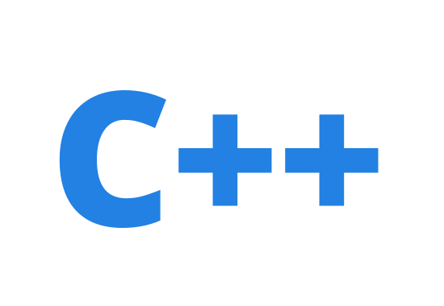
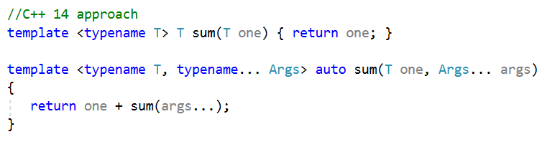
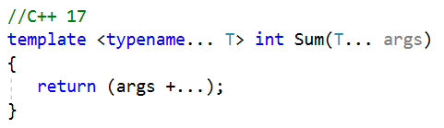
Fold Expression :
17
A very convenient feature in C++17 now, where-in we can do away with explicit unpacking of the parameter pack and an overloaded function to terminate recursion.
Needed to break recursion
Needed to for manual unwinding of parameter pack

Slide 51
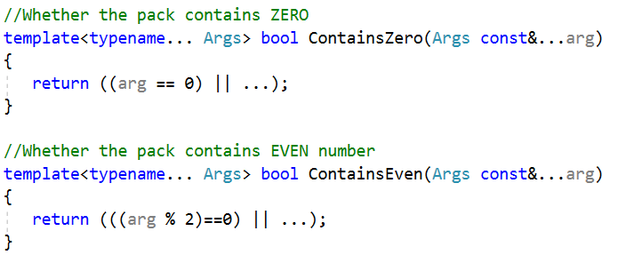
Unary fold expressions and empty parameter packs
17
Also we can make use of this new feature to concatenate an expanded pattern not by a comma separated list but by using an operator for a parameter pack.
For eg: fold expressions allow you to apply the same unary or binary operator to all elements of a parameter pack without going to the trouble of manually expanding the pack.
Where it would be expanded as
((arg1 == 0) || (arg2 == 0) || ... || (argN == 0))

Slide 52


Unary fold expressions and empty parameter packs : (contd…)
17
Unary right fold: If args is an empty pack, this is ill-formed for any operators but ||, && and , which will yield false, true and void(), respectively.
(arg1 + (arg2 + ( ... + argN)))
Binary right fold: Where X is some expression that is not a parameter pack. If arg is empty, this evaluates to X
(arg1 * ( ... * (argN * X))
Unary left fold: Like unary right fold, but with left association. The restrictions of unary right fold apply.
(((arg1 | arg 2) | ... ) | argN)
Binary left fold:
(((X > arg1) > ... ) > argN))

Slide 53
C++ 11
TEMPLATE FEATURES OVERVIEW
VARIADIC CLASS : A type that is capable of holding zero or more values, the types of which are specified as template arguments.
template<typename... Values> class Variadic;
A Variadic with zero arguments are easy to handle, because an empty specialization suffices:
template<> class Variadic <>{ };
The most important part of the Variadic class implementation is the recursive case, where we peel off the first argument (the Head) to be stored in the head data member, then derive from a Variadic class containing the remaining arguments (the Tail).
template<typename Head, typename... Tail>
class Variadic<Head, Tail...> : private Variadic<Tail...>
{
private:
Head head;
//...
};

Slide 54
C++ 11
TEMPLATE FEATURES OVERVIEW
Template instantiation & un-packing of the template parameter pack of the variadic class template can be seen like this…
Pack is empty
Variadic<int> obj1
class Variadic<int,< >>:private Variadic <Variadic< >>
{ };
Variadic<int, float> obj1;
class Variadic<int,<...>>:private Variadic<<...>> //step 1
{ };
class Variadic<int,float,<>>:private Variadic<< >> //step 2
{ };
Variadic<int, float, double> obj1;
class Variadic<int, <...>>:private Variadic<<...>> //step 1
{ };
class Variadic<int, float, <...>>:private Variadic<<...>> //step 2
{ };
class Variadic<int, float, double, < >>:private Variadic<< >> //step 3
{ };
Pack has values to process
Pack is now emptied

Slide 55
M
o
d
e
r
n
C
+
+
14
Variable Templates
C++14 allows variables to be templated:
template<typename T> constexpr T pi = T(3.1415926535897932385);
//C++14, a variable template in use
template<typename T> T circular_area(T r)
{
return pi<T> * r * r;
}
void main()
{
auto darea = circular_area(5.5); //uses pi<double>
auto farea = circular_area(5.5f); //uses pi<float>
cout << "darea =" << darea << endl;
cout << "farea =" << farea << endl;
}
Trainer: A.M.P.Ganesh Prabhu

Slide 56
C++ 11
TEMPLATE FEATURES OVERVIEW
TRADITIONAL APPROACH (TYPEDEF's)
typedef int value;
typedef void(*FP)();
template<typename T> class CA
{
typedef T value;
typedef T& reference;
typedef const T& const_reference;
typedef T* pointer;
typedef const T* const_pointer;
};

Slide 57
C++ 11
TEMPLATE FEATURES OVERVIEW
Template Aliases MODERN APPROACH
using value =int;
using FP = void(*)();
template<typename T> class CA
{
using value =T;
using reference = T&;
using const_reference = const T&;
using pointer = T*;
using const_pointer=const T*;
};
template<typename T> using mapobj = map<string, T>;

Slide 58
C++ 11
TEMPLATE FEATURES OVERVIEW
LOCAL TYPES AS TEMPLATE PARAMETERS
{
struct A //local type
{
string name() const { return ”I am local A”; }
};
vector<A> v1(10);
cout << v[0].name() << endl;
}
UN-NAMED TYPES AS TEMPLATE PARAMETERS
template<typename T> void print(const T &x) { x.print(); }
struct //unnamed type
{
int x=10;
void print()
{
cout << x << endl;
}
}a;
print(a);

Slide 59
C++ 11
TEMPLATE FEATURES OVERVIEW
EXTERN TEMPLATES
-------FILE1.H
#pragma once
template<typename T> T func(T &x)
{
//..
return x;
}
----------FILE1.CPP
#include “FILE1.H”
void f()
{
cout << func(10);
}
---------FILE2.CPP
extern template int func(int &);
void g()
{
cout << func(20);
}

Slide 60
C++ 11
Narrowing Conversions:-
vector<int> v1(10); //this syntax create 10 vector objects
vector<int> v2{ 10 }; //this syntax creates a single vector object & holds
//value 10
//for a move only type we cannot use { } syntax
vector<unique_ptr<int>> ptr{ unique_ptr<int>(new int(1)) }; //ERROR
vector<unique_ptr<int>> ptr;
ptr.push_back(unique_ptr<int>(new int(1))); //OK
auto x = 5; // ‘x’ is defined to be a integer variable & holds value 5
auto y{ 5 }; // ‘y’ is defined to be a initializer_list<int> object & holds
// value 5
template<typename T> void fun(T x) {….}
fun({1,2,3}); //ERROR
fun<initializer_list<int>> ({1,2,3}); //OK

Slide 61
C++ 11
Constexpr (Const expressions)
Constexpr, which stands for constant expressions is a new keyword in C++11. It can applied to both variables as well as functions to tell the compiler that they may be evaluated at compile-time, which is …
Good for performance as it ensures constant intialization at compile time
Constant expressions can be used in cases where constants are necessary for example, case labels, enum’s, template arguments etc..
Guaranteed not to cause race condition.
What is in a constant expression ?
Integer literal
Floating pointer literal
Enumerator
constexpr classes
constexpr functions
constexpr variables

Slide 62
C++ 11
Constexpr VARIABLES
A constexpr variable must be initialized at the point of declaration itself.
They cannot be initialized with a literal or constexpr value or a return value of a constexpr function.
auto a =10;
const auto b=a;
constexpr auto d=b; //ERROR
const auto c=10;
constexpr auto e=c; //OK

Slide 63
C++ 11
Constexpr FUNCTIONS
If a function is qualified to be ‘constexpr’, it means it can be evaluated at compile-time as long as all
its arguments are constant expressions. If not it will be evaluated at run-time.
Also ensure such functions comprise of a single return-type only.
Such functions qualified as ‘constexpr’ cannot be virtual.
All args are constexpr ?
Yes
No
Compile time
Run time
constexpr long fibonacci(int n)
{
return n < 1 ? -1:
(n == 1 || n ==2 ? 1:fibonacci(n-1) + fibonacci(n-2));
};
The result of the above function can used in an enum, for eg:
enum Fibonacci {Ninth = fibonacci(9), Tenth = fibonacci(10)};

Slide 64
C++ 11
Constexpr FUNCTIONS
The constexpr function in the previous slide can also be called at run-time
auto a=4,b=6;
cout << fibonacci(a+b) << endl;
The constexpr functions can be templated as well
template<typename T> constexpr auto square(const T &v) ->decltype(v *v)
{
return v*v;
}
The return types & parameters must always qualify to be a literal
LITERAL types
void
scalar types
Reference types referring to literal types
Arrays of literal types
Classes with the following requirements:-
Trivial destructor
All non-static data members and base classes are also literal types
It has atleast one constexpr constructor which isn't a copy or move constructor.

Slide 65
M
o
d
e
r
n
C
+
+
14
Relaxing constraints on constexpr functions
In C++11, `constexpr` function bodies could only contain a very limited set of syntaxes, including (but not limited to): `typedef`s, `using`s, and a single `return` statement. In C++14, the set of allowable syntaxes expands greatly to include the most common syntax such as `if` statements, multiple `return`s, loops, etc.
constexpr int factorial(int n)
{
if (n <= 1)
{ return 1; }
else
{ return n * factorial(n - 1); }
}
factorial(5); // == 120
Trainer: A.M.P.Ganesh Prabhu

Slide 66
C++ 11
Initializer lists and uniform initialization
We've always been able to use initializer lists with arrays, now you can do it with any type that has a method that takes an argument of type std::initializer_list<T> (including constructors). The standard library collections have all been updated to support initializer lists.
void foo() { vector<int> vecint = { 3, 5, 19, 2 }; }
map<int, double> mapintdoub = { { 4, 2.3}, { 12, 4.1 }, { 6, 0.7 } }; }
And it's trivial to do this with our own functions.
void bar1(const initializer_list<int> &nums)
{
for (auto i : nums)
{
// use i
}
}
bar1({ 1, 4, 6 });
We can also do it for our user defined types.
class bar2
{
public:
bar2(initializer_list<int> nums) { }
};
class bar3
{
public:
bar3(initializer_list<bar2> items) { }
};
bar2 b2 = { 3, 7, 88 };
bar3 b3 = { {1, 2}, { 14 }, { 11, 8 } };

Slide 67
C++ 11
Initializer lists and uniform initialization (contd..)
We've always been able to use initializer lists with arrays, now you can do it with any type that has a method that takes an argument of type std::initializer_list<T> (including constructors). The standard library collections have all been updated to support initializer lists.
Uniform initialization is a related feature that's been added to C++ 11. It automatically uses the matching constructor.
If there's an initializer-list constructor, it takes precedence over another matching constructor.
class bar4
{
int x; double y; string z;
public:
bar4(int, double, string) { }
};
class bar5
{
public:
bar5(int, bar4) { }
};
bar4 b4 { 12, 14.3, "apples" };
bar5 b5 { 10, { 1, 2.1, "bananas" } };
class bar6
{
public:
bar6(int, int) // (1)
{
// ...
}
bar6(initializer_list<int>) // (2)
{
// ...
}
};
bar6 b6 { 10, 10 }; // --> calls (2) above

Slide 68
C++ 11
Range based loop, enum’s, Assertions and Exception’s
Range-based for loop
nullptr
enum changes
Unicode support, raw string literals, user defined literals
Compile time assertions with static_assert
Exception specifications with noexcept

Slide 69
C++ 11
CONTROL FLOW (Range based for loop)
In addition to the earlier or old form of ‘for’ loop, C++11 now introduces a new ‘range based for’ loop. This construct helps us to automatically iterate over a range or collection of values like containers for example that incidentally support ‘begin’ & ‘end’ member functions with ease. For eg:
vector<int> v1;
//statements here to populate the vector…
//The new range based for loop usage for extracting the ‘int’s //contained in the vector
for(auto val: v1)
{
cout << val;
}
//now lets multiply every integer in the container with 5
for(auto &val:v1)
{
val = val*5;
}
Input received by value
Input received by reference

Slide 70
C++ 11
CONTROL FLOW (Range based for loop)
If in case we had our own custom container class and at the same time wanted to benefit from this range-based for loop to also work on instances of our own custom class, then we need to employ the ‘begin’ & ‘end’ member functions as follows:-
class MyContainer
{
private:
list<int> _values {100,200,300,400,500};
friend list<int>::iterator begin(MyContainer& cont);
friend list<int>::iterator end(MyContainer &cont);
public:
//… other functions
};
//global function
list<int>::iterator begin(Mycontainer &cont)
{
return const._values.begin();
}
list<int>::iterator begin(Mycontainer &cont)
{
return const._values.end();
}
void main()
{
MyContainer cont;
for(auto &elem : cont)
cout << elem << endl;
}

Slide 71
C++ 11
CONTROL FLOW (Range based for loop)
Diffference between for_each and range for construct
- From first-value to the last value always
- Can use ‘break’ and ‘continue’ keywords inside the loop construct if desired.
Range-for
…..
…..
From first-value to the last value (or)
From a specified starting point to an specified ending point as desired.
Cannot use ‘break’ and ‘continue’ keywords inside the loop construct.
for_each

Slide 72
C++ 11
nullptr
The ‘nullptr’ is a new keyword & stands for null pointer, which aims at replacing the keyword ‘NULL’ and zero(0).
The ‘nullptr’ is a Rvalue type and defined to be behave like a fundamental type.
namespace std
{
typedef decltype(nullptr) nullptr_t;
}
The ‘nullptr’ is still inter-operable with zero (0)
int *p = nullptr;
int *p1 = NULL;
int *p2=0;
p1 == p //true
p2 == p; //true
nullptr type is convertible to any pointer type or bool type only.
Now the standard library has been updated to used ‘nullptr’. For eg. A failed ‘dynamic_cast’ now returns ‘nullptr’ and not NULL

Slide 73
C++ 11
Nullptr (continued…)
If we use uniform initialization syntax for declaring pointers, by default the pointer variable will be initialized to ‘nullptr’
int *p { }; // p is set to nullptr
A nullptr is better than NULL
bool fun(int x)
{
return false;
}
bool fun(int *x)
{
return true;
}
void main()
{
fun(NULL); //returns false, fun(int) is chosen
fun(nullptr); //returns true, fun(int *) is chosen
}

Slide 74
C++ 11
Enum Changes
C++ 11 has introduced some small changes to enum,
Strongly typed enums in order to improve type safety
Forward declaration for enums for reducing coupling and reducing compiling time.
Scoped enums, we can now use enum class as against just enum, the names will not be exported outside.
enum class Proportion{ OneHalf, OneThird, OneQuarter };
Proportion prop = OneThird; //error
Proportion prop2 = Proportion::OneThird; //OK
A scoped enum is now not convertible to integer type, we need to do explicit conversion to work with enum values.
auto prop = Proportion::OneThird;
if(prop==1) //error
{
}
4) Another Ability of the scoped enum is to specify the underlying type, the type is specified after enum name and must be one of integral type, by default it is of type ‘int’

Slide 75
C++ 11
Enum Changes
Specifying the type helps improve cross platform compatibility of the code by helping the compiler choose the type stated by us rather than the compiler making its own choice.
enum class Direction :unsigned short { South, West, East, North };
cout <<sizeof(North) << endl; //outputs the size of unsigned short
enum class Color:double //ERROR, non-integral type
{
Black
};
FORWARD DECLARATION:
// CONTENTS OF HEADER FILE WITH ONLY ENUM NAME
enum class Direction; //forward declaration of enum
class CA
{
public:
void Input(Direction d){ ... }
void Print(Direction d)
{
cout <<"Direction is ...." << d << endl;
}
};

Slide 76
C++ 11
Enum Changes (Forward Declaration)
The following approach helps in data or information hiding when we are distributing our library
//navigator.h
class Navigator
{
private:
enum CompassPoint : int; //forward declaration
CompassPoint _compass_point;
public:
Navigator();
//...
};
//navigator.cpp
enum Navigator::CompassPoint : int {North, South, East, West };
Navigator::Navigator() : _compass_point(North)
{... }

Slide 77
C++ 11
Enum Changes (Forward Declaration)
There are several rules for forward declations..
Forward declaration has to include the type
The underlying type has to match between all declarations and definitions
Declarations can’t change from scoped to un-scoped or vice-versa.
enum E:short; //OK
enum F; //error, underlying type is required
enum class G:short; //OK SCOPED enum
enum E: short; //OK, redeclaration
enum class E:short; //ERROR, change from unscoped to scoped
enum G:short; //ERROR, can't change from scoped to unscoped
enum E:int; //ERROR, different underlying type

Slide 78
C++ 11
Compile time assertions:-
Unlike the runtime assertions in order to check pre and post conditions for a function, these compile time assertions are statically checked during compile time,
The advantage of this approach is some errors can be detected very early before we even run the software and they don’t incur any runtime overhead.
Many compile-time checks are implemented in template or generic programming and work on expression which can be evaluated during compile time.
They can be used to narrow the definitions of acceptable types in our templates, which can improve type safety of the code.
We can use them to validate non-type template parameters as well.
Enforce requirements of type sizes while compiling.
Compile time assertions are carried out using ‘static_assert’. For example on cross platform code it may be useful to perform assertions on built-in type & static_assert provides us a way to provide our own message which will be printed by the compiler if the assertion fails.
int fun(int a, int b)
{
static_assert(sizeof(int) <=4, "int must not exceed 4 bytes");
//...
}

Slide 79
C++ 11
Compile time assertions:-
The following example does a pre-condition check on non-type template parameter
template<unsigned int DIMENSION> class Matrix
{
public:
Matrix()
{
static_assert(DIMENSION <= 3, "Dimensions must not exceed 3");
}
};
void main()
{
Matrix<3> m3; //OK
Matrix<4> m4; //ERROR ‘Dimensions must not exceed 3’
}

Slide 80
C++ 11
Compile time assertions:-
The following example illustrates the utility of static_assert, which verifies during compile-time whether the base class derived has virtual destructor or not. The static_assert call can be in a function scope or class scope. In this example observe the ‘static_assert’ statement is not inside a member function body, rather in a class definition.
class Base1
{
public:
virtual ~Base1() { }
};
class Base2
{
public:
//no virtual destructor
};
template<typename T> class Derived : public T
{
static_assert(has_virtual_destructor<T>::value,
"Instantiating class type must have virtual destructor");
public:
Derived() { }
};
void main()
{
Derived<Base1> d1;//OK
Derived<Base2> d2; //triggers static_assert
}

Slide 81
C++ 11
Literals :-
The functionality of literals has got expanded a little, C++11 has now acquired a number of literals to represent ..
Unicode literals to represent different encodings
Raw literals – which don’t allow special characters & the 3rd change is
To allow user-defined literals with custom suffixes.
Unicode support for 3 different types of string literals
u8”UTF-8: \u00BD” //prefix ‘u8’ are UTF-8 encoded strings
u“UTF-16: \uA654” //prefix ‘u’ are UTF-16 encoded strings
U”UTF-32: \U0002387F” //prefix ‘U’ are UTF-32 encoded strings
Prefix
Character Type
String Type
u8
char
string
u
char16_t
u16string
U
char32_t
u32string

Slide 82
C++ 11
Literals :-
In addition to 3 string literals there is 2 unicode character literals
Prefix
Character Type
Example literal
u
char16_t
u'\u160E'
U
char32_t
U'\U0000160E'
Please note: There is no u8 unicode support for character types

Slide 83
C++ 11
Raw string literals
VC++ 2013 & above now supports raw string literals.
Note that it does not support Unicode string literals.
These raw string literal allows you to avoid having escape special characters which can be handy with HTML, XML, and regular expressions.
For eg: auto s1 = R"(This is a "raw" string)";
now s1 is const char* holding the string This is a "raw" string
If we want to embed R"(...)" in a string literal. In that case, we can use the following syntax.
auto s2 = R“!!(Example: R"(This is my raw string)")!!";
Now s2 contains - Example: R"(This is my raw string)". In this example, we have used !! as a delimiter. This delimiter can be any string up to 16 characters in length. Raw string literals can contain newlines too.
R"(multiline // is same as "multiline\nliteral"
literal)"

Slide 84
C++ 11
User Defined Literals
Another new & interesting feature in C++ 11 is user-defined literals, these are marked with suffixes instead of prefixes, by analogy of suffixes for number literals. For example…
1.2_i; //express complex numbers
10_km; // kilometers, express units
The suffixes _i and _km themselves are not part of the language, they helps us attach units or type-information with numeric literals.
The user-defined literals can also make the code more readable.
widget.set_height(150_px);
widget.set_width(80_percent);
The above can be achieved by overloading literal operators
//create a 'complex' instance from an imaginary literal operator
constexpr complex<double> operator "" _i(long double d)
{
return {0,d};
}
Note: The operator name starts with a pair of double quotes without any blank space “” further followed by a single blank space & then a literal suffix ‘_i’. And we cannot redefine built-in literals
Literal Operator

Slide 85
C++ 11
User Defined Literals
A user-defined suffix can be added to 4 different types of literals, viz…
1. Integer literals
2. Floating point literals
3. Character literals
4. String literals
operator "" _suffix(unsigned long long)
operator "" _suffix(const char* )
template<char... Digits> operator "" _suffix()
operator "" _suffix(long double)
operator "" _suffix(const char* )
template<char... Digits> operator "" _suffix()
operator "" _suffix(char)
operator "" _suffix(wchar_t)
operator "" _suffix(char16_t)
operator "" _suffix(char32_t)
operator "" _suffix(const char*)
operator "" _suffix(const wchar_t*)
operator "" _suffix(const char16_t*)
operator "" _suffix(const char32_t*)

Slide 86
C++ 11
Exception Specification
noexcept:-
When move semantics was added it turned out that some classes which where working fine with 03 would now automatically acquire a move constructor & would throw exceptions and as a result some operations on STL containers which provided strong guarantee will no longer provide it. The noexcept is a specifier that can be used in function declarations or definitions.
The ‘noexcept’ specifier is by-product of move semantics to the language
noexcept specifier means functions should not throw
Compiler generated functions are noexcept if all the operations they directly invoke are noexcept
delete operators and user defined destructors are noexcept unless explicitly specified otherwise
void fun() noexcept
{
//….
}
Note: The noexcept specifier is no compile-time check, if any function qualified with ‘noexcept’ happens to throw an exception, then the control would be transferred to ‘terminate’ function and stack unwinding is not expected to happen under this situation & the unexpected function never gets called either.

Slide 87
C++ 11
Exception Specification
When to use noexcept
You are not likely to use it a lot; the default is to allow functions to throw
Prefer to use it with small functions which are easy to analyze
Avoid noexcept if your functions has preconditions
Move constructors and move assignment operators should be noexcept if possible.
A couple of things to note in the context of function pointers…
double Compute(int x) noexcept
{
//…
}
double(*fp1)(int) = &Compute; //OK, but ‘noexcept’ is lost
double(*fp2)(int) noexcept = &Compute; //OK, ‘noexcept’ is preserved.

Slide 88
C++ 11
Other Language Features:-
Explicit conversion operators
Inline Namespaces
alignof & alignas
Changed restrictions on unions.

Slide 89
C++ 11
Explicit qualifier & conversion functions:
Now the ‘explicit’ qualifier which is applied for the one arg. Constructors, also known as ‘conversion constructors’, can now be applied to conversion functions also.
Now, with C++ 11, we can apply explicit on your conversion operators /functions too.
Then
class Test1
{
public:
explicit Test1(int) { }
};
class Test2
{
int x;
public:
Test2(int i) : x(i) { }
operator Test1() //conversion f’n
{
return Test1(x);
}
};
void Foo()
{
Test2 t1 = 20;
Test1 t2 = t1; //will compile
} //Test1 t2 = t1.operator Test1();
class Test2
{
int x;
public:
Test2(int i) : x(i) { }
explicit operator Test1() //conversion f’n
{
return Test1(x);
}
};
void Foo()
{
Test2 t1 = 20;
Test1 t2 = t1; //will not compile
Test1 t3 =(Test1) t1; //OK
}

Slide 90
C++ 11
Inline Namespaces:-
Inlining of namespaces provide a way for implementing versioning for library.
If we inline namespaces its content become visible in the outer namespace. Thereby the outer namespace name is enough to access the elements in the namespace that has been inlined.
namespace API
{
inline namespace v2 //latest version2
{
//v2 processes doubles instead of ints
void process(vector<double>)
{ }
}
namespace v1 //the old version1
{
void process(vector<int>)
{ }
}
}
void main()
{
vector<double> double_val;
API::process(double_val);
vector<int> int_val;
API::v1::process(int_val);
}

Slide 91
C++ 11
Inline Namespaces:-
namespace API
{
inline namespace v2 //old version2 not inline
{
//v2 processes doubles instead of ints
void process(vector<double>)
{ }
}
namespace v1 //the old version1
{
void process(vector<int>)
{ }
}
inline namespace v3 //latest version3
{
//v3 processes floats now
void process(vector<floats>)
{ }
}
}
With a introduction of a new inline namespace v3 it is now possible to access the functionalities from this v3 namespace with the outer API namespace. Where as the inline namespace v2 does not qualify to be inlined anymore. Access to the members of v2 namespace shall be thru its namespace name v2 alone.

Slide 92
C++ 11
Inline Namespaces:-
A scenario where inline namespace is better over using namespace statement:-
namespace A
{
namespace B
{
template<typename T> CA{};
}
using namespace B;
//specialize the generic class CA here
template<> CA<char> { };
//ERROR, using namespace does not help
}
namespace A
{
inline namespace B
{
template<typename T> CA{};
}
//specialize the generic class CA here
template<> CA<char> { };
//OK will work fine
}

Slide 93
C++ 11
[ alignof and alignas in GCC ] [ _alignof and align in VC++ ]
C++11 has introduced 2 new keywords related to alignment.
1) _alignof :-
Returns a unsigned int, which is the largest word alignment requirement of its arguments which is an expression.
For eg:
_alignof(double); //yields 8
sizeof(double); //also yields 8
But consider the following implementation
struct CA
{
int a;
char c;
double b;
};
cout <<"sizeof(CA) is " << sizeof(CA) << endl; //yields 16
cout <<"alignof(CA) is" << _alignof(CA) << endl; //yields 8
_alignof(T &) implies or yields _alignof(T)
_alignof(T[N]) implies or yields _alignof(T)

Slide 94
C++ 11
[ alignof and alignas in GCC ] [ _alignof and align in VC++ ]
Alignas specifies how type for an object should be aligned, it can be applied to variables, class data members and class declarations.
//This type now has a 32-byte alignment attribute, meaning that all //instances must start on a 32-byte boundary
alignas(32) int arr[10];
alignas(double) unsigned char arr[256];
class S
{
private:
alignas(32) Buffer _buf;
};
//The alignas keyword should be enclosed between class specifier & //the class name
//The requested alignment for classes must always be a power of 2.
class alignas(2 * alignof(double)) Doubled
{
//..
};

Slide 95
C++ 11
Changed restrictions on Union types
The restrictions on unions has changed in C++11
Members of types with user defined constructors, destructors and assignment operations are allowed
Member types can't have virtual function or to be reference types
If a non-static data member of a union ever belongs to a class having a trivial constructor/destructor or copy constructor or move constructor, then the same function of the union itself gets implicitly deleted. To overcome this we have to write our own special methods in the union.
Then ....
union Compact
{
int i;
string s;
};
Compact c1; //error

Slide 96
C++ 11
Changed restrictions on Union types
Now
union Compact
{
int i;
string s;
Compact():i(10) { }
~Compact() { }
};
Compact c1; //OK, now compiles
cout << c1.i << endl; //outputs 10
Further to initialize the string data member we can go ahead with placement new operator
new(&c1.s) string(“mystring”);
//sometime later
c1.s.~string(); //an explicit call to string class destructor

Slide 97
C++ 11 & 14 Library Features
Memory Management
Multithreading [Concurrency Library]
User-defined literals for standard types
Compile-time Integer sequences

Slide 98
C++ 11
MEMORY MANAGEMENT
unique_ptr
shared_ptr
weak_ptr

Slide 99
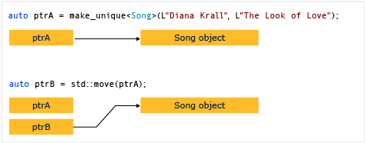
C++ 11
MEMORY MANAGEMENT unique_ptr
A unique_ptr does not share its pointer. It cannot be copied to another unique_ptr, passed by value to a function, or used in any Standard Template Library (STL) algorithm that requires copies to be made. A unique_ptr can only be moved. This means that the ownership of the memory resource is transferred to another unique_ptr and the original unique_ptr no longer owns it. We recommend that you restrict an object to one owner, because multiple ownership adds complexity to the program logic. Therefore, when you need a smart pointer for a plain C++ object, use unique_ptr, and when you construct a unique_ptr, use the make_unique helper function.
The following diagram illustrates the transfer of ownership between two unique_ptr instances.

Slide 100
M
o
d
e
r
n
C
+
+
14
std::make_unique & std::make_shared
std::make_unique` (C++14 feature) and std::make_shared (C++11 feature) is the recommended way to create instances of `std::unique_ptr`s and shared_ptr instances due to the following reasons:
Avoid having to use the `new` operator.
Prevents code repetition when specifying the underlying type the pointer shall hold.
Most importantly, it provides exception-safety. And more efficient when compared to direct ‘new’ operator function call.
Trainer: A.M.P.Ganesh Prabhu

Slide 101
unique_ptr
[ CODE SEGMENT ]
Default delete_handler to de-allocate heap memory
-----
------
unique_ptr<int> p2 = unique_ptr<int>(new int(100));
Default delete Handler
p2
int* p
Pointer to the memory
int* p1 = new int(100);
OR
[ ] handlers
int* p1
[ CODE SEGMENT ]
CUSTOM delete_handler …
To de-allocate heap memory
-----
------
Custom delete Handler
Pointer to the custom_deleters
or built-in deleters
STACK
100
100
HEAP

Slide 102
unique_ptr
unique_ptr<int> p1 = make_unique<int>(100);
[ CODE SEGMENT ]
Default delete_handler to de-allocate heap memory
-----
------
Default delete Handler
p1
NULL
Pointer to the memory
OR
[ ] handlers
[ CODE SEGMENT ]
CUSTOM delete_handler …
To de-allocate heap memory
-----
------
Custom delete Handler
Pointer to the custom_deleters
or built-in deleters
STACK
100
HEAP
A unique_ptr instance is always an exclusive owner of an heap memory, It cannot be shared by another unique_ptr instance.

Slide 103
unique_ptr
unique_ptr<int> p1 = make_unique<int>(100);
unique_ptr<int> p2(move(p1)); //ok - RVALUE COPY ALLOWED
[ CODE SEGMENT ]
Default delete_handler to de-allocate heap memory
-----
------
Default delete Handler
p1
p2
NULL
Pointer to the memory
int* p
OR
[ ] handlers
[ ] handlers
[ CODE SEGMENT ]
CUSTOM delete_handler …
To de-allocate heap memory
-----
------
Custom delete Handler
Pointer to the custom_deleters
or built-in deleters
STACK
100
HEAP
A unique_ptr instance is always an exclusive owner of an heap memory, It cannot be shared by another unique_ptr instance.

Slide 104
unique_ptr
unique_ptr<IData> ptr;
ptr = make_unique<DataA>();
[ CODE SEGMENT ]
Default delete_handler to de-allocate heap memory
-----
------
Pointer to the custom_deleters
or built-in deleters
ptr
ptr
Default delete Handler
IData* p
IData* p=nullptr
OR
[ ] handlers
[ ] handlers
[ CODE SEGMENT ]
CUSTOM delete_handler …
To de-allocate heap memory
-----
------
Custom delete Handler
STACK
DataA
HEAP

Slide 105
unique_ptr
unique_ptr<IData> ptr;
ptr = make_unique<DataA>();
[ CODE SEGMENT ]
Default delete_handler to de-allocate heap memory
-----
------
Pointer to the custom_deleters
or built-in deleters
Default delete Handler
ptr
IData* p
OR
[ ] handlers
[ CODE SEGMENT ]
CUSTOM delete_handler …
To de-allocate heap memory
-----
------
Custom delete Handler
STACK
DataA
HEAP

Slide 106
unique_ptr
unique_ptr<IData> ptr;
ptr = make_unique<DataA>();
[ CODE SEGMENT ]
Default delete_handler to de-allocate heap memory
-----
------
Pointer to the custom_deleters
or built-in deleters
Default delete Handler
ptr
ptr = make_unique<DataB>();
IData* p
OR
[ ] handlers
[ CODE SEGMENT ]
CUSTOM delete_handler …
To de-allocate heap memory
-----
------
Custom delete Handler
STACK
DataA
DataB
HEAP

Slide 107
unique_ptr
[ CODE SEGMENT ]
Default delete_handler to de-allocate heap memory
-----
------
unique_ptr<IData> ptr;
ptr = make_unique<DataA>();
Default delete Handler
OR
[ CODE SEGMENT ]
CUSTOM delete_handler …
To de-allocate heap memory
-----
------
Custom delete Handler
ptr
IData* p
[ ] handlers
STACK
DataA
HEAP

Slide 108
unique_ptr
[ CODE SEGMENT ]
Default delete_handler to de-allocate heap memory
-----
------
void Some_Business(IData* p)
{
//....
}
Default delete Handler
OR
[ CODE SEGMENT ]
CUSTOM delete_handler …
To de-allocate heap memory
-----
------
Custom delete Handler
ptr
IData* p
[ ] handlers
IData* p
STACK
Some_Business(ptr.get());
DataA
HEAP

Slide 109
unique_ptr
[ CODE SEGMENT ]
Default delete_handler to de-allocate heap memory
-----
------
void Some_Business(IData* p)
{
//..
}
Default delete Handler
OR
[ CODE SEGMENT ]
CUSTOM delete_handler …
To de-allocate heap memory
-----
------
Custom delete Handler
ptr
When Some_Business terminates
IData* p
[ ] handlers
IData* p
STACK
Some_Business(ptr.get());
DataA
HEAP

Slide 110
unique_ptr
[ CODE SEGMENT ]
Default delete_handler to de-allocate heap memory
-----
------
void Some_Business(IData* p)
{
//..
}
Default delete Handler
OR
[ CODE SEGMENT ]
CUSTOM delete_handler …
To de-allocate heap memory
-----
------
Custom delete Handler
ptr
IData* p
[ ] handlers
IData* p
ptr = make_unique<DataB>();
STACK
Some_Business(ptr.get());
DataA
DataB
HEAP

Slide 111
unique_ptr
[ CODE SEGMENT ]
Default delete_handler to de-allocate heap memory
-----
------
Default delete Handler
OR
[ CODE SEGMENT ]
CUSTOM delete_handler …
To de-allocate heap memory
-----
------
Custom delete Handler
ptr
IData* p
[ ] handlers
ptr = make_unique<DataB>();
STACK
DataB
HEAP

Slide 112
unique_ptr
[ CODE SEGMENT ]
Default delete_handler to de-allocate heap memory
-----
------
void Some_Business(IData* p)
{
//....
delete p;
}
Default delete Handler
OR
[ CODE SEGMENT ]
CUSTOM delete_handler …
To de-allocate heap memory
-----
------
Custom delete Handler
ptr
IData* p
[ ] handlers
IData* p
STACK
Some_Business(ptr.release());
DataB
HEAP

Slide 113
unique_ptr
[ CODE SEGMENT ]
Default delete_handler to de-allocate heap memory
-----
------
void Some_Business(IData* p)
{
//....
delete p;
}
Default delete Handler
OR
[ CODE SEGMENT ]
CUSTOM delete_handler …
To de-allocate heap memory
-----
------
Custom delete Handler
When a call to Some_Business terminates
ptr
IData* p
[ ] handlers
IData* p
STACK
Some_Business(ptr.release());
DataB
HEAP

Slide 114
unique_ptr
[ CODE SEGMENT ]
Default delete_handler to de-allocate heap memory
-----
------
unique_ptr<DataA, function<void(DataA*)>> Aptr1 = make_unique<DataA>();
OR
Aptr1
IData* p
[ ] handlers
STACK
DataA
HEAP

Slide 115
unique_ptr
[ CODE SEGMENT ]
Default delete_handler to de-allocate heap memory
-----
------
unique_ptr<DataA, function<void(DataA*)>> Aptr1 = make_unique<DataA>();
Default delete Handler
OR
Aptr1.get_deleter() = deleter1;
[ CODE SEGMENT ]
CUSTOM delete_handler …
To de-allocate heap memory
-----
------
Custom delete Handler
Aptr1
IData* p
[ ] handlers
STACK
//DELETER-1
auto deleter1 = [](DataA *p)
{
cout << "deleter1 execution started..." << endl;
cout << "Handling Custom deletion for DataA type..." << endl;
delete p;
cout << "deleter1 execution completed..." << endl;
};
DataA
HEAP

Slide 116
unique_ptr
unique_ptr<DataA[], function<void(DataA*)>> ptr1 = make_unique<DataA[]>(5);
[ CODE SEGMENT ]
Default delete_handler to de-allocate heap memory
-----
------
STACK
ptr1
Resource* p
[ CODE SEGMENT ]
CUSTOM delete_handler Arr_deleter[ ]
To de-allocate heap memory
-----
------
[ ] handlers
HEAP
Resource1
Resource2
…
Resource5

Slide 117
unique_ptr
unique_ptr<DataA[], function<void(DataA*)>> ptr1 = make_unique<DataA[]>(5);
[ CODE SEGMENT ]
Default delete_handler to de-allocate heap memory
-----
------
STACK
Aptr2
Resource* p
[ CODE SEGMENT ]
CUSTOM delete_handler deleter3[ ]
To de-allocate heap memory
-----
------
[ ] handlers
Aptr2.get_deleter() = deleter3;
HEAP
Resource1
Resource2
…
Resource5

Slide 118
unique_ptr
unique_ptr<Resource[]> ptr1 = make_unique<Resource[]>(5);
[ CODE SEGMENT ]
Default delete_handler to de-allocate heap memory
-----
------
Default delete Handler
OR
Custom delete Handler
[ CODE SEGMENT ]
custom delete_handler to de-allocate heap memory
-----
------
ptr1
IData* p
[ ] handlers
Arr_deleter
STACK
0
0
0
0
0
Resource types
HEAP

Slide 119
unique_ptr
unique_ptr<Resource[]> ptr2 (new Resource[4]{ {},{200},{},{500} } );
[ CODE SEGMENT ]
Default delete_handler to de-allocate heap memory
-----
------
Default delete Handler
OR
Custom delete Handler
[ CODE SEGMENT ]
custom delete_handler to de-allocate heap memory
-----
------
ptr2
IData* p
[ ] handlers
Arr_deleter
STACK
0
200
0
500
Resource types
HEAP

Slide 120
unique_ptr
unique_ptr<Resource[],function<void(Resource*)>> ptr2(new Resource[4]{{10},{20}},Arr_deleter);
[ CODE SEGMENT ]
Default delete_handler to de-allocate heap memory
-----
------
Default delete Handler
OR
Custom delete Handler
[ CODE SEGMENT ]
custom delete_handler to de-allocate heap memory
-----
------
ptr2
IData* p
[ ] handlers
Arr_deleter
STACK
10
20
0
0
Resource types
HEAP

Slide 121
C++ 11
MEMORY MANAGEMENT unique_ptr
The following example shows how to create unique_ptr instances and use them in a vector.
In the range for loop, notice that the unique_ptr is passed by reference. If you try to pass by value here, the compiler will throw an error because the unique_ptr copy constructor is deleted.
void SongVector()
{
vector<unique_ptr<Song>> songs;
// Create a few new unique_ptr<Song> instances
// and add them to vector using implicit move semantics.
songs.push_back(make_unique<Song>(L"B'z", L"Juice"));
songs.push_back(make_unique<Song>(L"Namie Amuro", L"Funky Town"));
songs.push_back(make_unique<Song>(L"Kome Kome Club", L"Kimi ga Iru Dake de"));
songs.push_back(make_unique<Song>(L"Ayumi Hamasaki", L"Poker Face"));
// Pass by const reference when possible to avoid copying.
for (const auto& song : songs)
{
wcout << L"Artist: " << song->artist << L" Title: " << song->title << endl;
}
}

Slide 122
C++ 11
MEMORY MANAGEMENT shared_ptr
The shared_ptr type is a smart pointer in the C++ standard library that is designed for scenarios in which more than one owner might have to manage the lifetime of the object in memory. After you initialize a shared_ptr you can copy it, pass it by value in function arguments, and assign it to other shared_ptr instances. All the instances point to the same object, and share access to one "control block" that increments and decrements the reference count whenever a new shared_ptr is added, goes out of scope, or is reset. When the reference count reaches zero, the control block deletes the memory resource and itself.
The following illustration shows several shared_ptr instances that point to one memory location.
shared_ptr
sp
Weak counter
shared_ptr
sp
Strong counter
Object

Slide 123
C++ 11
MEMORY MANAGEMENT shared_ptr
Whenever possible, use the make_shared (<memory>) function to create a shared_ptr when the memory resource is created for the first time. make_shared is exception-safe. It uses the same call to allocate the memory for the control block and the resource, and thereby reduces the construction overhead. If you do not use make_shared, then you have to use an explicit new expression to create the object before you pass it to the shared_ptr constructor. The following example shows various ways to declare and initialize a shared_ptr together with a new object.
// Use make_shared function when possible.
auto sp1 = make_shared<Song>(L"The Beatles", L"Im Happy Just to Dance With You");
// Ok, but slightly less efficient.
// Note: Using new expression as constructor argument
// creates no named variable for other code to access.
shared_ptr<Song> sp2(new Song(L"Lady Gaga", L"Just Dance"));
// When initialization must be separate from declaration, e.g. class members,
// initialize with nullptr to make your programming intent explicit.
shared_ptr<Song> sp5(nullptr);
//Equivalent to: shared_ptr<Song> sp5;
//...
sp5 = make_shared<Song>(L"Elton John", L"I'm Still Standing");

Slide 124
ptr2
shared_ptr
ptr3
###
CA*
###
CA*
Pointer to Control Block
Pointer to Control Block
ptr
ptr1
ptr4
CA*
###
###
CA*
###
CA*
Pointer to Control Block
Pointer to Control Block
Pointer to Control Block
Stack memory
Heap memory
CA object
Pointer to CA object
CONTROL BLOCK
Strong_count
5
Weak_count
0
Handle to deleter
and More..

Slide 125
ptr1
shared_ptr
ptr2
###
CA*
###
CA*
Pointer to Control Block
Pointer to Control Block
ptr
ptr3
ptr4
CA*
###
###
CA*
###
CA*
Pointer to Control Block
Pointer to Control Block
Pointer to Control Block
Stack memory
Heap memory
CA object
Pointer to CA object
CONTROL BLOCK
Strong_count
4
Weak_count
0
Handle to deleter
and More..

Slide 126
ptr1
shared_ptr
ptr2
###
CA*
###
CA*
Pointer to Control Block
Pointer to Control Block
ptr
ptr3
ptr4
CA*
###
###
CA*
###
CA*
Pointer to Control Block
Pointer to Control Block
Pointer to Control Block
Stack memory
Heap memory
CA object
Pointer to CA object
CONTROL BLOCK
Strong_count
3
Weak_count
0
Handle to deleter
and More..

Slide 127
ptr1
shared_ptr
ptr2
###
CA*
###
CA*
Pointer to Control Block
Pointer to Control Block
ptr
ptr3
ptr4
CA*
###
###
CA*
###
CA*
Pointer to Control Block
Pointer to Control Block
Pointer to Control Block
Stack memory
Heap memory
CA object
Pointer to CA object
CONTROL BLOCK
Strong_count
2
Weak_count
0
Handle to deleter
and More..

Slide 128
ptr1
shared_ptr
ptr2
###
CA*
###
CA*
Pointer to Control Block
Pointer to Control Block
ptr
ptr3
ptr4
CA*
###
###
CA*
###
CA*
Pointer to Control Block
Pointer to Control Block
Pointer to Control Block
Stack memory
Heap memory
CA object
Pointer to CA object
CONTROL BLOCK
Strong_count
1
Weak_count
0
Handle to deleter
and More..

Slide 129
ptr1
shared_ptr
ptr2
###
CA*
###
CA*
Pointer to Control Block
Pointer to Control Block
ptr
ptr3
ptr4
CA*
###
###
CA*
###
CA*
Pointer to Control Block
Pointer to Control Block
Pointer to Control Block
Stack memory
Heap memory
CA object
Pointer to CA object
CONTROL BLOCK
Strong_count
0
When ‘main() terminates, both strong_count and weak_count values in control block become 0, now the CA instance and the control block will get de-allocated from heap
Weak_count
0
Handle to deleter
and More..

Slide 130
shared_ptr
ptr1
ptr2
CA*
###
nullptr
CA*
Pointer to Control Block
Pointer to Control Block
Stack memory
CA object
Heap memory
Pointer to CA object
Strong_count
1
CONTROL BLOCK
Weak_count
0
Handle to deleter
and More..

Slide 131
shared_ptr
shared_ptr<CA> ptr2 = make_shared<CA>();
ptr1
ptr2
CA*
###
###
CA*
Stack memory
Pointer to Control Block
Pointer to Control Block
CA object
Pointer to CA object
CA object
Strong_count
1
CONTROL BLOCK
Strong_count
1
Heap memory
Weak_count
0
Weak_count
0
Handle to deleter
and More..
Handle to delete
and More..

Slide 132
shared_ptr
shared_ptr<CA> ptr2;
ptr2 = ptr1;
(or)
shared_ptr<CA> ptr1 = make_shared<CA>();
shared_ptr<CA> ptr2(ptr1);
ptr1
ptr2
CA*
###
###
CA*
Pointer to Control Block
Pointer to Control Block
Stack memory
Heap memory
CA object
Strong_count
2
Weak_count
0
CONTROL BLOCK
Handle to delete
and More..

Slide 133
shared_ptr
Improper usage of shared_ptr instance, that leads to double delete
//A Bad idea
shared_ptr<CA> ptr1(p);
CA *p = new(nothrow) CA;
ptr1
CA* p
CA*
###
Stack memory
Pointer to Control Block
CA object
Heap memory
CA* ###
Strong_count
1
Weak_count
0
CONTROL BLOCK
Handle to delete
and More..

Slide 134
shared_ptr
Improper usage of shared_ptr instance, that leads to double delete
//A Bad idea
shared_ptr<CA> ptr1(p);
shared_ptr<CA> ptr2(p);
CA *p = new(nothrow) CA;
ptr2
ptr1
CA* p
CA*
###
###
CA*
Stack memory
Pointer to Control Block
Pointer to Control Block
CA object
Heap memory
CA* ###
CA* ###
Strong_count
1
Strong_count
1
Weak_count
0
Weak_count
0
CONTROL BLOCK
Handle to delete
and More..
Handle to delete
and More..

Slide 135
shared_ptr
Improper usage of shared_ptr instance, that leads to double delete
When ptr2 & ptr1 PERISH from stack
Ptr2 perishes
ptr1
ptr2
CA* p
CA*
###
###
CA*
Stack memory
Pointer to Control Block
Pointer to Control Block
CA object
CA* ###
delete applied by ptr2
CA* ###
Heap memory
delete applied by ptr1
Strong_count
1
Strong_count
0
Weak_count
0
Weak_count
0
Handle to delete
and More..
CONTROL BLOCK
Handle to delete
and More..

Slide 136
shared_ptr
Improper usage of shared_ptr instance, that leads to double delete
When ptr2 & ptr1 PERISH from stack
Ptr2 perishes
Ptr1 perishes
ptr1
ptr2
CA* p
CA*
###
###
CA*
Stack memory
Pointer to Control Block
Pointer to Control Block
A double delete attempt is being made
CA object
delete applied by ptr1
CA* ###
delete applied by ptr2
CA* ###
Heap memory
Strong_count
0
Strong_count
0
Weak_count
0
Weak_count
0
Handle to delete
and More..
CONTROL BLOCK
Handle to delete
and More..

Slide 137
shared_ptr
shared_ptr<CA> ptr1 = make_shared<CA>();
ptr1
CA*
Stack memory
Pointer to Control Block
Heap memory
CA
Strong_count
1
Weak_count
0
CONTROL BLOCK
Handle to delete
and More..

Slide 138
shared_ptr
A demo on ‘reset’
shared_ptr<CA> ptr1 = make_shared<CA>();
ptr1.reset();
ptr1
CA*
Stack memory
Pointer to Control Block
Heap memory
A call to the ‘reset’ would decrement the strong count by one, thus if the strong_count upon decrement falls to zero, then object on heap would be de-allocated.
If both strong_count and weak_count are zero control block will get de-allocated from the heap
CA
Strong_count
0
Weak_count
0
CONTROL BLOCK
Handle to delete
and More..

Slide 139
shared_ptr
Either [copy construct] (or) [assign]
shared_ptr<CA> ptr1 = make_shared<CA>();
shared_ptr<CA> ptr2(ptr1);
ptr1
ptr2
CA*
CA*
Stack memory
Pointer to Control Block
Pointer to Control Block
Heap memory
CA
Strong_count
2
Weak_count
0
CONTROL BLOCK
Handle to delete
and More..

Slide 140
shared_ptr
shared_ptr<CA> ptr1 = make_shared<CA>();
shared_ptr<CA> ptr2(ptr1);
ptr1.reset();
ptr1
ptr2
CA*
NULL
CA*
Stack memory
Pointer to Control Block
Pointer to Control Block
Heap memory
CA
A call to the ‘reset’ would decrement the strong count by one, thus if the strong_count upon decrement falls to zero, then object on heap would be de-allocated.
Strong_count
1
Weak_count
0
CONTROL BLOCK
Handle to delete
and More..

Slide 141
shared_ptr
shared_ptr<CA[]> ptr1 (new CA[5]);
ptr1
CA*
###
Stack memory
Pointer to Control Block
CA
CA
CA
CA
CA
Heap memory
CA*
Strong_count
1
Weak_count
0
CONTROL BLOCK
Handle to delete
and More..

Slide 142
shared_ptr
shared_ptr<CA[]> ptr1 (new CA[5]);
shared_ptr<CA[]> ptr2(ptr1);
ptr1
ptr2
CA*
###
###
CA*
Stack memory
Pointer to Control Block
Pointer to Control Block
CA
CA
CA
CA
CA
Heap memory
CA*
Strong_count
2
Weak_count
0
CONTROL BLOCK
Handle to delete
and More..

Slide 143
C++ 11
MEMORY MANAGEMENT shared_ptr
The following example shows how to declare and initialize shared_ptr instances that take on shared ownership of an object that has already been allocated by another shared_ptr. Assume that sp2 is an initialized shared_ptr.
//Initialize with copy constructor. Increments ref count.
auto sp3(sp2);
//Initialize via assignment. Increments ref count.
auto sp4 = sp2;
//Initialize with nullptr. sp7 is empty.
shared_ptr<Song> sp7(nullptr);
// Initialize with another shared_ptr. sp1 and sp2
// swap pointers as well as ref counts.
sp1.swap(sp2);

Slide 144
C++ 11
MEMORY MANAGEMENT weak_ptr
Sometimes an object must store a way to access the underlying object of a shared_ptr without causing the reference count to be incremented. Typically, this situation occurs when you have cyclic references between shared_ptr instances.
By using a weak_ptr, you can create a shared_ptr that joins to an existing set of related instances, but only if the underlying memory resource is still valid. A weak_ptr itself does not participate in the reference counting, and therefore, it cannot prevent the reference count from going to zero. However, you can use a weak_ptr to try to obtain a new copy of the shared_ptr with which it was initialized. If the memory has already been deleted, a bad_weak_ptr exception is thrown. If the memory is still valid, the new shared pointer increments the reference count and guarantees that the memory will be valid as long as the shared_ptr variable stays in scope.
auto sp = make_shared<Object>();
weak_ptr<Object> wp=sp;
sp.reset();
weak_ptr
wp
Weak counter
shared_ptr
sp
Strong counter
Object

Slide 145
shared_ptr with weak_ptr
shared_ptr<CA> ptr1(new CA());
shared_ptr<CA> ptr2(ptr1);
ptr1
ptr2
Stack memory
CA*
CA*
Pointer to Control Block
Pointer to Control Block
Heap memory
CA object
Pointer to CA object
Strong_count
2
Weak_count
0
CONTROL BLOCK
Handle to delete
and More..

Slide 146
shared_ptr with weak_ptr
shared_ptr<CA> ptr1(new CA());
shared_ptr<CA> ptr2(ptr1);
weak_ptr<CA> wk1 = ptr1
ptr1
ptr2
wk1
Stack memory
CA*
CA*
CA*
Pointer to Control Block
Pointer to Control Block
Pointer to Control Block
Heap memory
CA object
Pointer to CA object
Strong_count
2
Weak_count
1
CONTROL BLOCK
Handle to delete
and More..

Slide 147
shared_ptr with weak_ptr
shared_ptr<CA> ptr1(new CA());
shared_ptr<CA> ptr2(ptr1);
weak_ptr<CA> wk1 = ptr1
CA*
ptr3
Pointer to Control Block
auto ptr3 = wk1.lock();
ptr1
ptr2
wk1
Stack memory
CA*
CA*
CA*
Pointer to Control Block
Pointer to Control Block
Pointer to Control Block
Heap memory
CA object
Pointer to CA object
Strong_count
3
Weak_count
1
CONTROL BLOCK
Handle to delete
and More..

Slide 148
shared_ptr with weak_ptr
shared_ptr<CA> ptr1 = make_shared<CA>();
weak_ptr<CA> wk1(ptr1);
ptr1
wk1
Stack memory
CA*
CA*
Pointer to Control Block
Pointer to Control Block
Heap memory
A weak_ptr is in a VALID state, if the strong count is NOT zero.
If the strong_count falls to zero, then the weak_ptr goes into an INVALID or EXPIRED state.
CA object
Strong_count
1
Weak_count
1
CONTROL BLOCK
Handle to delete
and More..

Slide 149
shared_ptr with weak_ptr
shared_ptr<CA> ptr1 = make_shared<CA>();
weak_ptr<CA> wk1(ptr1);
ptr1.reset();
ptr1
wk1
Stack memory
CA*
NULL
CA*
Pointer to Control Block
Pointer to Control Block
Heap memory
CA object
When ptr1 perishes (or) call to reset() with ptr1 strong count becomes zero
Strong_count
0
Weak_count
1
CONTROL BLOCK
Handle to delete
and More..

Slide 150
shared_ptr with weak_ptr
shared_ptr<CA> ptr1 = make_shared<CA>();
weak_ptr<CA> wk1(ptr1);
ptr1.reset();
ptr1
wk1
Stack memory
CA*
NULL
CA*
Pointer to Control Block
Pointer to Control Block
Heap memory
Expired
CA object
Strong_count
0
CONTROL BLOCK
Weak_count
1
The moment strong_count becomes zero, ‘wk1’ goes into expired state
Handle to delete
and More..

Slide 151
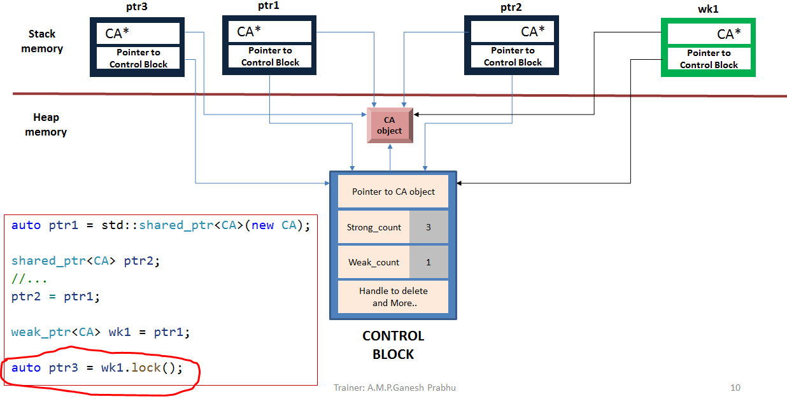
shared_ptr with weak_ptr

Slide 152
shared_ptr with weak_ptr
2
weak_ptr is still in the valid state, inspite of ‘reset’ call with ‘ptr1’, as the strong count is greater than zero.
ptr1.reset();

Slide 153
shared_ptr with weak_ptr

Slide 154
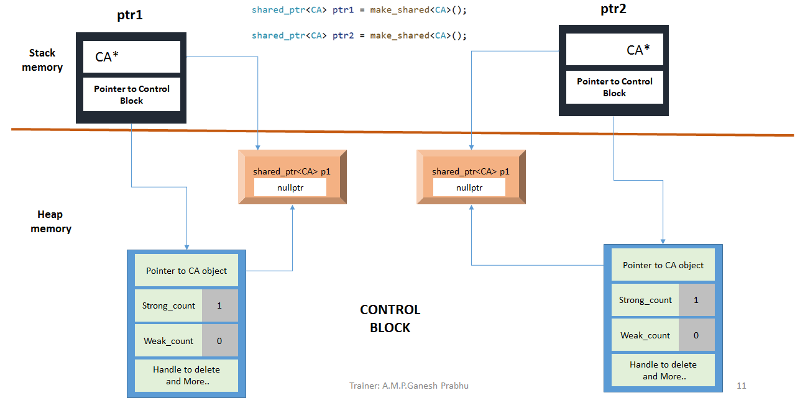
shared_ptr & weak_ptr [circular reference]
CA
CA

Slide 155
shared_ptr & weak_ptr [circular reference]
Strong link
shared_ptr & weak_ptr [circular reference]
ptr1->Set(ptr2);
CA
CA
2
The contents of ‘ptr2’ gets assigned to ‘p1’ data member of the CA object owned by ‘ptr1’

Slide 156
shared_ptr & weak_ptr [circular reference]
Strong link
shared_ptr & weak_ptr [circular reference]
ptr2->Set(ptr1);
CA
CA
2
2
The contents of ‘ptr1’ gets assigned to ‘p1’ data member of the CA object owned by ‘ptr2’

Slide 157
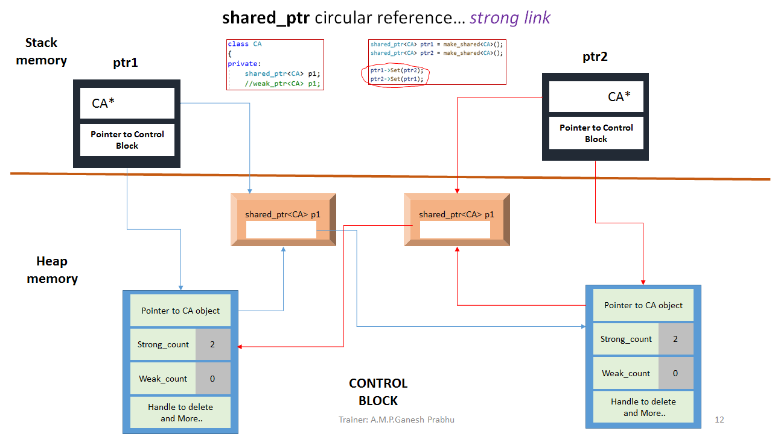
shared_ptr & weak_ptr [circular reference]
Strong link
perishes
CA
CA
1

Slide 158
shared_ptr & weak_ptr [circular reference]
Strong link
perishes
perishes
CA
CA
Dead-lock, neither CA instances will die
1
1

Slide 159
shared_ptr & weak_ptr [circular reference] weak link
class CA
{
private:
//shared_ptr<CA> p1;
weak_ptr<CA> p1;
shared_ptr<CA> ptr1 = make_shared<CA>();
shared_ptr<CA> ptr2 = make_shared<CA>();
ptr2
ptr1
CA*
Stack memory
CA*
Pointer to Control Block
Pointer to Control Block
Heap memory
CA
CA
weak_ptr<CA> p1
weak_ptr<CA> p1
nullptr
nullptr
CA*
CA *
Strong_count
1
CONTROL BLOCK
Strong_count
1
CONTROL BLOCK
Weak_count
0
Weak_count
0
Handle to delete
and More..
Handle to delete
and More..

Slide 160
shared_ptr & weak_ptr [circular reference] weak link
class CA
{
private:
//shared_ptr<CA> p1;
weak_ptr<CA> p1;
shared_ptr<CA> ptr1 = make_shared<CA>();
shared_ptr<CA> ptr2 = make_shared<CA>();
ptr1->Set(ptr2);
ptr2->Set(ptr1);
ptr2
ptr1
CA*
Stack memory
CA*
Pointer to Control Block
Pointer to Control Block
Heap memory
CA
CA
weak_ptr<CA> p1
weak_ptr<CA> p1
###
###
CA*
CA *
Strong_count
1
Strong_count
1
Weak_count
1
Weak_count
1
Handle to delete
and More..
CONTROL BLOCK
Handle to delete
and More..

Slide 161
shared_ptr & weak_ptr [circular reference] weak link
class CA
{
private:
//shared_ptr<CA> p1;
weak_ptr<CA> p1;
shared_ptr<CA> ptr1 = make_shared<CA>();
shared_ptr<CA> ptr2 = make_shared<CA>();
ptr1->Set(ptr2);
ptr2->Set(ptr1);
ptr2
perishes
ptr1
CA*
Stack memory
CA*
Pointer to Control Block
Pointer to Control Block
Heap memory
CA
CA
weak_ptr<CA> p1
weak_ptr<CA> p1
###
###
CA*
CA *
Strong_count
1
Strong_count
0
Weak_count
0
Weak_count
1
Handle to delete
and More..
CONTROL BLOCK
Handle to delete
and More..

Slide 162
shared_ptr & weak_ptr [circular reference] weak link
class CA
{
private:
//shared_ptr<CA> p1;
weak_ptr<CA> p1;
shared_ptr<CA> ptr1 = make_shared<CA>();
shared_ptr<CA> ptr2 = make_shared<CA>();
ptr1->Set(ptr2);
ptr2->Set(ptr1);
ptr2
perishes
perishes
ptr1
CA*
CA*
Pointer to Control Block
Stack memory
Pointer to Control Block
CA
CA
weak_ptr<CA> p1
weak_ptr<CA> p1
Heap memory
###
###
CA*
CA *
Strong_count
0
Strong_count
0
Weak_count
0
Weak_count
0
Handle to delete
and More..
CONTROL BLOCK
Handle to delete
and More..

Slide 163
shared_ptr
Singleton DP, Modern approach
static shared_ptr<Singleton> ptr1;
Singleton *p = new(nothrow) Singleton;
ptr1
Singleton* p
Sing*
nullptr
stack memory
Pointer to Control Block
Singleton object
Heap memory
CONTROL BLOCK

Slide 164
shared_ptr
Singleton DP, Modern approach
static shared_ptr<Singleton> ptr1;
Singleton *p = new(nothrow) Singleton;
shared_ptr<Singleton> ptr2(p);
ptr1
Singleton* p
ptr2
Sing*
nullptr
###
Sing*
Stack memory
Pointer to Control Block
Pointer to Control Block
Singleton object
Sing* ###
Strong_count
1
Weak_count
0
Handle to delete
and More..
Heap memory
CONTROL BLOCK

Slide 165
shared_ptr
Singleton DP, Modern approach
static shared_ptr<Singleton> ptr1;
Singleton *p = new(nothrow) Singleton;
shared_ptr<Singleton> ptr2(p);
ptr1.swap(ptr2);
ptr1
Singleton* p
ptr2
Sing*
###
nullptr
Sing*
Stack memory
Pointer to Control Block
Pointer to Control Block
Singleton object
Sing* ###
Strong_count
1
Weak_count
0
Handle to delete
and More..
Heap memory
CONTROL BLOCK

Slide 166
Introduction to the C++ Multithreading Libraries

Slide 167

Concurrent Models
Generally there are 2 types of concurrent programming models
Multiprocessing
Multithreading
Multiprocessing
Each process has only one thread running.
All the processes communicate with each other thru a inter-process communication channel, such as files, pipes, message queues etc.,
Advantage: Can be run on distributed system
Dis-advantage:Slow to start and involves a lot of overheads.
Multithreading
A single process may contain two or more threads .
Each of these threads communicate with each other thru a shared memory.
Advantage: Very fast to start and low overhead.
Dis-advantage: Cannot be run on distributed system & difficult to implement.
Process 1
Process 2
Inter-process communication
Shared Memory
Single Process
11

Slide 168
Multithreading in C++ 11
Objective: How to create or write C++ code that make use of multi-core processors
Thread : A thread is a software entity and it represents an independent unit of execution in a program.
A std::thread object represents a single thread of execution.
C++ 11 multithreading library abstracts away all the platform-specific code, you can easily write sophisticated and portable code that runs across all major platforms.
For example: on POSIX systems, a std::thread uses the Pthreads API, and on Win32 it uses the native CreateThread and related calls.
A std::thread object is normally constructed by passing the threading function or method it is to run.
11

Slide 169
Life of a thread
Each process starts with one thread, the master or main thread.
Before a new thread can be used, it must be created.
The main thread can have one or more child threads.
Each thread executes independently of the other threads.
An application should make the best use of its threads because each thread may run on its own processor and the presence of idle threads is synonymous with resource waste.
11

Slide 170
Life of a thread (contd...)
Parameter to a thread object can be any callable entity, that is
A global function
A static method of a class
A named Function object
A nameless Function object, subject to it is wrapped within parenthesis.
Joining of thread or detaching it can only be done once.
It is a good idea to verify whether a thread is 'joinable' before trying to 'join' it.
The decision of joining a thread or detaching thread has to be made before the thread object goes out of scope.
The thread objects cannot be copy constructed & can only be 'moved' [Transfer ownership]
Parameters to a thread object are always passed by value.
Blindly calling a 'join' on a detached thread is not advisable.
11

Slide 171
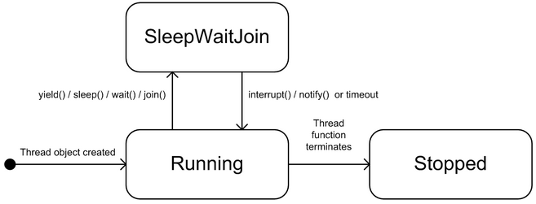
Life of a thread (contd)
What is happening in a thread after it has been created and it is yet to be destroyed? A general answer is that it is either executing or not executing. The latter state may have several causes:
It is sleeping.
It is waiting on some other thread.
It is blocked, that is it is waiting on system resources to perform an input or output operation.
The scheduler is responsible for some of the transitions between states:
Running: the thread has been created and is already started or is ready to start (this is a runnable state). The scheduler has allocated processor time for the thread.
SleepWaitJoin: the thread is waiting for an event to trigger. The thread will be placed in the Running state when this event triggers.
Stopped: the thread function has run its course (has completed).
11

Slide 172
How threads communicate
A multi-threaded application consists of a collection of threads.
Each thread is responsible for some particular task in the application.
In order to avoid anarchy we need to address a number of important issues:
Synchronisation:
Ensuring that an event in one thread notifies another thread. This is called event synchronisation.
Another type of synchronisation is mutual exclusion that gives a thread exclusive access to a shared variable or to some other resource for a certain amount of time. This ensures the integrity of the shared variable when multiple threads attempt to access and modify it. We place a lock on the resource and failure to do this may result in a race condition. This occurs when multiple threads share data and at least one of the threads accesses this data without using a defined synchronisation mechanism.
Scheduling:
we order the events in a program by imposing some kind of scheduling policy on them. In general, there are more concurrent tasks to be executed than there are processors to run them. The scheduler synchronises access to the different processors on a CPU. Thus the scheduler determines which threads are currently executing on the available processors.
11

Slide 173
The C++ 11 thread class
This class represents a thread. It has member functions for creating threads, firing up threads, thread synchronisation and notification, and finally changing thread state.
There are three constructors in thread:
Default constructor.
Create a thread with an instance of a callable type (which can be a function object, a global or static function) as argument. This function is run when the thread fires up that is, after thread creation.
Create a thread with a callable type and its bound arguments to the thread constructor.
The callable type – which plays the role of the thread function – can be a free function, a static member function or a function callable object.
The thread function has a 'void' return type and when it has finished the thread that called it will stop executing.
11

Slide 174
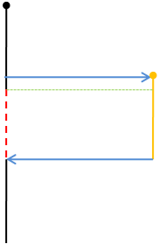
Multithreading in C++ 11
When working with std:thread you should use the following header file:
#include <thread >
and the following namespace:
(a)
using namespace std;
The application starts, and the main thread runs at (a).
Then at (b), the main thread spawns the worker thread by constructing a thread object with the worker function.
Right after, at (c), the main thread calls join on the thread, which means it will go to sleep (and not consume any CPU time) until the worker thread has completed.
As soon as the worker thread is created at (b), it will start execution.
At some point later at (d), the worker completes.
Since the main thread was joining on its completion, main wakes up and continues running.
It finishes at (e) and the process terminates.
(b)
(c)
(d)
11
(e)

Slide 175
Thread creation
Type 1: A Thread Function
std::thread Thread1(&function-name);
Type 2: Function with Arguments
void fun(const char *p, int x);
std::thread Thread1(&fun, “Hello”, 100);
Type 3: Functor
class Func {…}; //expected to have function operator overloaded
Func fObject;
std::thread Thread1(fObject);
Type 4: Object method
class Func {…}; //expected to have function ‘myFun’
Func fObject;
std::thread Thread1(&Func::myfun, &fObject); // Syntax 1, if this statement is inside a global function.
std::thread Thread1(&Func::myfun, this); // Syntax 2, if this statement is inside a member function
11

Slide 176
packaged_task<>
A thread class instance cannot help us hold return values of the function spawned as a thread directly. To overcome this deficiency, we wrap the function that has to be spawned as thread in an object of the type ‘packaged_task’.
And then provide the packaged_task instance as a parameter to the thread instance. By using ‘get_future’ member function we can access the functions return result, which would be stored in a special memory called “shared memory”.

Slide 177
// Create a packaged_task<> that encapsulated the callback i.e. a function
std::packaged_task<std::string (std::string)> task(getDataFromDB);
task
getDataFromDB
-------------
String(*fp)(string);
String* pointee;
// Fetch the associated future<> from packaged_task<>
std::future<std::string> result = task.get_future();
Upon thread getting spawned with ‘task’ as its object, the result returned by the function is stored on the shared memory.
result
String* pointee;
Data fetched from DB by Filter ::Args
Shared_memory

Slide 178
// Create a packaged_task<> that encapsulated the callback i.e. a function
std::packaged_task<std::string (std::string)> task(getDataFromDB);
task
getDataFromDB
-------------
String(*fp)(string);
String* pointee;
// Fetch the associated future<> from packaged_task<>
std::future<std::string> result = task.get_future();
data
Data fetched from DB by Filter ::Args
Upon thread getting spawned with ‘task’ as its object, the result returned by the function is stored on the shared memory.
result
String* pointee;
result.get();
Data fetched from DB by Filter ::Args
Upon the value getting retrieved from the shared memory with the help of ‘get’ function call, the shared memory will get de-allocated.
Shared_memory

Slide 179
Thread synchronization
One of the attention points when writing multi-threaded code is to determine how to organise threads in such a way that access to shared data is done in a controlled manner.
This is because the order in which threads access data is non-deterministic and this can lead to inconsistent results; called race conditions. A classic example is when two threads attempt to withdraw funds from an account at the same time. The steps in a sequential program to perform this transaction are:
Check the balance (are there enough funds in the account?).
Give the amount to withdraw.
Commit the transaction and update the account.
When there are two threads involved then steps 1, 2 and 3 will be interleaved which means the threads can update data in a non-deterministic way. For example, the scenario in following table shows that after withdrawing 70 and 90 money units the balance is -60 money units which destroys the invariant condition.
Thread 1 | Thread 2 | Balance
If(70 > balance) |  | 100
 | If(90 > balance) | 100
balance = balance - 70 |  | 30
 | balance = balance - 90 | -60
11

Slide 180
Mutex
Helps in synchronization of accessing a common resource.
In general any global resource under a lock can still be accessed by a some other thread by by-passing the lock.
Any global resource if it has to be totally protected by an mutex completely, a mutex must be completely bounded to the resource it is protecting.
Design interface appropriately such that the data is thread safe.
It is a good idea to lock mutexes in the same order across functions, failing which it could lead to situation called dead-lock.
In other words encapsulate the resource, that is make both the resource as well as the mutex object as class data member.
11

Slide 181
Regular Mutex
The simplest form of mutex is a regular std::mutex.
You lock and unlock it, and only one thread can lock the mutex at a time.
Any thread that calls lock() on a mutex held by another thread will block indefinitely (an important factor when considering synchronisation).
11

Slide 182
Timed Mutex
The std::timed_mutex class is a subtype of std::mutex, which adds the ability to specify a timeout.
For example, you may wish to try to lock the mutex but give up after a certain time if you cannot obtain a lock.
This takes either an absolute time, or a relative time.
If the mutex cannot be obtained within the time specified, the call will return false and the mutex is not held.
If the mutex is locked within the timeout period, it returns true.
11

Slide 183
Recursive Mutex
Normally a mutex is locked only once, then unlocked.
Depending on the structure of your application, there may be times when it would be useful to be able to lock a mutex multiple times on the same thread (in very special circumstances, such as nested method calls).
By using a recursive mutex, it can be locked as many times as necessary, provided it is unlocked the same number of times.
Thus all these methods can be called individually, as they all lock the resources, and in a nested fashion, as the mutex can be locked multiple times.
Provided the mutex is unlocked the same number of times (which is a matter of care and thought), the mutex will be correctly released by the end of the nested operation.
11

Slide 184
Shared Mutex
Some concurrency scenarios involve having one writer and many readers.
For example, one thread may be downloading data from the network, while another thread is displaying the data on the screen, and a third thread is saving the data to a database.
So the downloading thread will be locking for writing, and the other two only for reading.
There is therefore no reason why the display thread and the database thread (which both only read the shared resource) need to exclude the other; concurrent reading is perfectly safe.
17

Slide 185
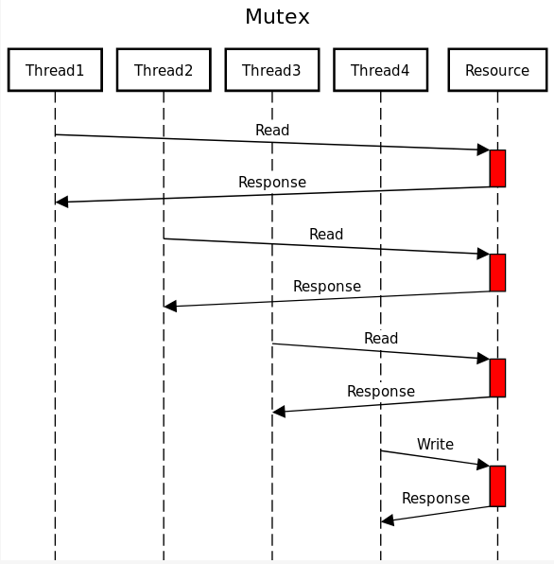
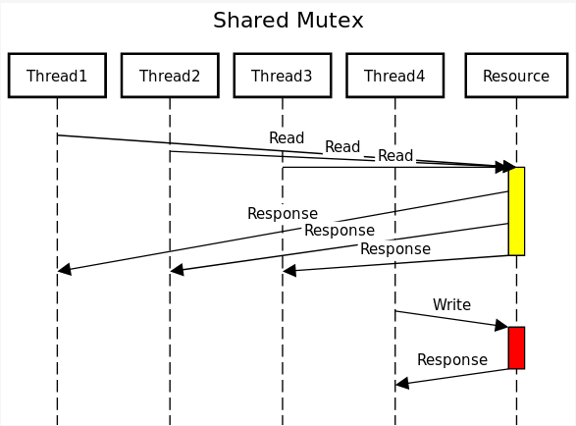
Shared Mutex
The image shows how multiple readers can access the same resource at the same time, but when a writer has the resource, nobody else can access it. If we were using a regular mutex, the program would run slower because all threads would have to wait for the mutex:
17

Slide 186
Summary
The table below summarises the difference mutex types, and their main distinguishing features:
std::mutex | Normal mutex, most commonly used, blocking lock | has lock() and try_lock()
std::timed_mutex | Adds ability to timeout waiting for a lock | adds timed_lock() to wait for lock with a timeout
std::recursive_mutex | `lock()` can be called multiple times on the “same” thread
std::shared_mutex | lock can be upgraded to allow multiple readers or a single writer | can upgrade locks (R->W)

Slide 187
Dead Locks
In a non-trivial application, there may be several threads and numerous mutexes.
When more than one thread locks more than one mutex, there arises the potential for a condition known as a deadlock.
This is where one thread is holding a lock while waiting for another to become available, while a second thread is holding the second lock and waiting for the first lock to become available.
Since they are both waiting for each other to finish, neither can run.
This deadlocked situation can be more involved, whereby several threads form a ring of holding and waiting for locks.
This is illustrated in the following diagram.
11

Slide 188
Avoiding Dead Locks
Prefer locking single mutex.
Avoid locking a mutex and then calling a user provided function
Use the global 'lock' to lock more than one mutex, other wise
Lock the mutex in the same order.
11

Slide 189
Thread Notification
wait(): thread A releases the lock when wait() is called; A then sleeps until another thread B calls notify().
notify(): signals a change in an object related to thread B. Then one waiting thread (in this case A) wakes up after the lock has been released.
notify_all(): this has the same intent as notify() except that all waiting threads wake up.
11

Slide 190
Condition Variable
Whenever threads need to asynchronously signal to one another that an event has occurred or a condition is true, A condition variable becomes handy.
A condition variable, which acts like a flag or signal that can be used to safely and efficiently notify() one or more other threads asynchronously that a condition is true.
The code which manages the state creates the condition variable and updates it, using the condition to notify others of the change in state.
Implementation details: There are two important details relating to how condition variables are implemented that affect their use:
A condition variable must be protected by a mutex, and
A condition variable needs an actual variable to be used as a flag.
Declaring a Condition variable
std::condition_variable data_ready_cond;
std::mutex data_ready_mutex;
bool data_ready = false;
The code which is interested in monitoring the state can wait() (a blocking call) on the condition (which means it needs to be in a separate thread) where it will consume no cycles until the condition is raised.
11

Slide 191
std::future
The std::future<> template is used to represent the result of a computation that potentially happens in the future.
An object of type std::future<T> represents a proxy for an object of type T that will potentially be produced in the future.
Loosely speaking, std::future enables a calling code to wait or block for an event to happen—the event of producing a value of a certain type.
This mechanism can be used to signal events and pass values or exceptions from one thread to another.
11

Slide 192
std::promise
The producer of the value or the source of the event needs a way to communicate with the future object in the calling thread.
For this, an object of type std::promise<T>,associated with the future object in the calling thread, is used to signal events and send values.
Thus std::future and std::promise objects work in pairs to signal events and pass values across threads.
11

Slide 193
std::promise & std::future
A std::promise is a input channel & std::future is an output channel, Objects of both these classes establish a safe communication channel between threads
Thread A
Thread B
std::promise<string> prms;
promise
When a promise object gets constructed a shared state is allocated automatically.
It is in this shared state memory the value will be stored.
Shared State
11

Slide 194
std::promise & std::future
A std::promise is a input channel & std::future is an output channel, Objects of both these classes establish a safe communication channel between threads
Thread A
Thread B
The next step is to obtain the future from the promise.
promise
std::promise<string> prms;
std::future<string> ftr;
ftr = prms.get_future();
future
At this point both future and promise share the shared_state memory.
This shared_state memory is reference counted, when both objects promise and future go out of scope the memory is automatically released.
Shared State
11

Slide 195
std::promise & std::future
A std::promise is a input channel & std::future is an output channel, Objects of both these classes establish a safe communication channel between threads
Thread A
Thread B
We create a thread and pass (move) the promise to the thread.
promise
future
std::promise<string> prms;
std::future<string> ftr;
ftr = prms.get_future();
std::thread th(&thFun, std::move(prms));
The synchronization of the shared state is automatically provided by the system.
If a future object tries to get the value even before promise could set the same, then it will block & wait until the promise sets the value.
Shared State
11

Slide 196
std::promise & std::future
A std::promise is a input channel & std::future is an output channel, Objects of both these classes establish a safe communication channel between threads
std::promise<string> prms;
std::future<string> ftr;
ftr = prms.get_future();
std::thread th(&thFun, std::move(prms));
Thread A
Thread B
promise
future
Thread B
prms.set_value("Hello from future");
Sets the data
Shared State
Hello from future
11

Slide 197
std::promise & std::future
A std::promise is a input channel & std::future is an output channel, Objects of both these classes establish a safe communication channel between threads
std::promise<string> prms;
std::future<string> ftr;
ftr = prms.get_future();
std::thread th(&thFun, std::ref(prms));
Thread A
Thread B
promise
future
Thread A receives the data from shared memory thru future object
As the data gets moved out, the shared state would become invalid thereafter
Shared State
Gets the data
Thread A
std::string str = ftr.get();
Hello from future
11

Slide 198
std::promise & std::future
A std::promise is a input channel & std::future is an output channel, Objects of both these classes establish a safe communication channel between threads
std::promise<string> prms;
std::future<string> ftr;
ftr = prms.get_future();
std::thread th(&thFun, std::move(prms));
Thread A
Thread B
promise
future
After this stage, the shared state changes to an invalid state as the value gets moved.
Under the circumstances calling 'get' for the second time would be an error.
Gets the data
Shared State
Thread A
Hello from future
std::string str = ftr.get();
11

Slide 199
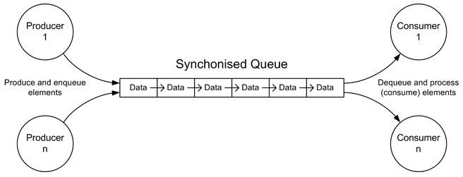
Producer-Consumer Pattern
This pattern is useful in a variety of situations.
There are many applications of this pattern. In general, one or more producer agents write information to a synchronised queue while one or more consumer agents extract information from the queue.
It is possible to extend the pattern to support multiple queues.
The Producer-Consumer Pattern is depicted in Figure
11

Slide 200
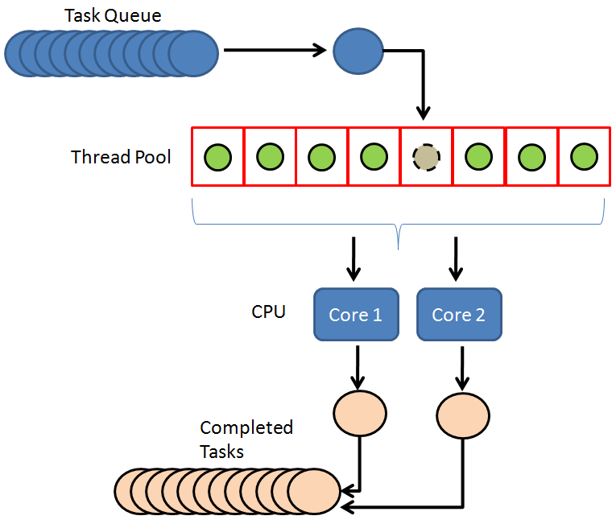
Thread Pool
A thread pool consists of 'm' of threads, created to perform a number n of tasks concurrently. Typically 'm' is not equal to 'n';
Instead, the number of threads is tuned to the computing resources available to handle tasks in parallel (processors, cores, memory).
While the number of tasks depends on the problem and may not be known upfront.
Reasons for using a thread pool, rather than the obvious alternative of spawning one thread per task, are to
prevent the time and memory overhead inherent in thread creation,
and to avoid running out of resources such as open files or network connections (of which operating systems allocate a limited number to running programs).
A common way of distributing the tasks to threads (scheduling the tasks for execution) is by means of a synchronized queue known as a task queue. The threads in the pool take tasks off the queue, perform them, then return to the queue for their next task.
11

Slide 201
M
o
d
e
r
n
C
+
+
14
User-defined literals for standard library types
New user-defined literals for standard library types, including new built-in literals for `chrono` and `basic_string`. These can be `constexpr` meaning they can be used at compile-time. Some uses for these literals include compile-time integer parsing, binary literals, and imaginary number literals.
The suffix ‘s‘ is added in string literal to signify it as a string type. Consider the code below.
auto s=”Happy new year!” ; //s is ‘const char*’ type
auto st=”Happy”s ; //st is ‘string’ type
auto str=”new” , str1= “addition”s ; //error
The suffixes ‘h‘, ‘min‘, ‘s‘, ‘ms‘, ‘us‘, ‘ns‘ is used to denote various chrono::duration time intervals.
to sec=60s ; //s is chrono::seconds type
auto hr=2h ; //hr is chrono::hours type
auto mls=56ms ; //mls is chrono:milli-seconds
For complex class there are some suffixes which specify the literals as complex<float> ,complex<double> and complex<long double>.The suffixes are : ‘if‘, ‘i‘, ‘il‘.
auto comd=345i ; //comd is complex<double> type
auto comld=234il ; //comld is complex<long double> type

Slide 202
M
o
d
e
r
n
C
+
+
14
Compile-time integer sequences
The class template `std::integer_sequence` represents a compile-time sequence of integers. There are a few helpers built on top from the header file <utility>:
`std::make_integer_sequence<T, N...>` - creates a sequence of `0, ..., N - 1` with type `T`.
`std::index_sequence_for<T...>` - converts a template parameter pack into an integer sequence.
Convert an array into a tuple:
template<typename Array, std::size_t... I>
decltype(auto) a2t_impl(const Array& a, std::integer_sequence<std::size_t, I...>);
template<typename T, std::size_t N, typename Indices = std::make_index_sequence<N>>
decltype(auto) a2t(const std::array<T, N>& a);
std::array<int, 4> array = {1,2,3,4};
// convert an array into a tuple
auto tuple = a2t(array);
cout << tuple << '\n‘;

Slide 203
Parallel Algorithms of the Standard Template Library
17
std::adjacent_difference | std::is_partïtioned | std::replace_if
std::adjacent_find | std::is_sorted | std::reverse
std::all_of | std::is_sorted_until | std::reverse_copy
std::any_of | std::lexicographical_compare | std::rotate
std::copv | std::max_element | std::rotate_copy
std::copyif | std::merge | std::search
std::copy_n | std::min_element | std::search_n
std::count | std::minmax_element | std::set_difference
std::count_if | std::mismatch | std::set_intersection
std::equal | std::move | std::set_symmetric_difference
std::fill | std::none_of | std::set_union
std::fill_n | std::nth_elment | std::sort
std::find | std::partial_sort | std::stable_partition

Slide 204
Parallel Algorithms of the Standard Template Library
17
std::find_end | std::partial_sort_copy | std::stable_sort
std::find_first_of | std::partition | std::swap_ranges
std::find_if | std::partition_copy | std::transform
std::find_if_not | std::remove | std::uninitialized_copv
std::generate | std::remove_copy | std::uninitialized_copy_n
std::generate_n | std::remove_copy_if | std::uninitialized_fill
std::includes | std::remove_if | std::uninitialized_fìll_n
std::inner_product | std::replace | std::unique
std::inplace_merge | std::replace_copy | std::unique_copy
std::is_heap | std::is_heap_until | std::replace_copy_if

Slide 205
Parallel Algorithms of the Standard Template Library
17
Execution Policy
The C++17 standard defines three execution policies:
std::execution::seq: runs the program sequentially
std::execution::par: runs the program in parallel on multiple
threads
std::execution::par_unseq: runs the program in parallel on
multiple threads and allows the interleaving of individual loops;
permits a vectorized version with (Single Instruction Multiple Data).
#include<iostream>
#include<vector>
#include<algorithm>
#include<execution>
using namespace std;
int main()
{
std::vector<int> v = {1, 2, 3, 4, 5, 6, 7, 8, 9};
// standard sequential sort
std::sort(v.begin(), v.end());
// sequential execution
std::sort(std::execution::seq, v.begin(), v.end());
// permitting parallel execution
std::sort(std::execution::par, v.begin(), v.end());
// permitting parallel and vectorized execution
std::sort(std::execution::par_unseq, v.begin(), v.end());
return 0;
}

